Slide 1

Qualifications and Training for TFCAs
22 March 2017
Capacity Building CoP Session
SADC TFCA Network Meeting
Holiday Inn, Sandton
Johannesburg, South Africa

Slide 2
Careers in TFCAs
Warden/ PA manager
TFCA Management (general professions)
Ranger/Scout
Policy researcher
Policy Advisor
Tourism officer
PA Management in TFCAs (conservation professions)
Senior Wildlife Officer/ Ranger
Technical/ maintenance staff
Business and accounting
Marketing and communication
(Social) Ecologist
TFCA Coordinator
GIS and Spatial planner
Business and accounting
Marketing and communication
PA Management in TFCAs (specialist professions)
TFCA negotiator
TFCA Management (specialist professions)
TFCA Sustainability planner
Extension services
Veterinarian
Veterinarian
Notes:
Reminder of slide shown earlier
This slide outlines various types of careers in TFCAs, organised roughly by categories.
For PA Management, there is a formal career progression through 4 levels reflected, but for the other categories, only some career options are noted, but no progression necessarily shown.
Again, for PA Management there is a lot of information available already and a lot of focus in terms of capacity building. For other topics and careers, this information was not accessed ahead of the workshop, but may be available in more detail – to be discussed

Slide 3
Careers in TFCAs cont’d
Tourism in TFCAs
Community Development in TFCAs
Community liaison/outreach
Conflict resolution specialist
Skill-set identification specialist
Hospitality Industry
Event Management
Research in
TFCAs (Sciences)
Species research
Ecosystem research
Socio-economic research
Guide
Tracker
Professional Hunter
Policy and law research
Research in
TFCAs (Humanities)
Governance research
Sustainability research
Veterinary research
Human health research
Tourism research
NB: not exhaustive!
Notes:
Reminder of slide shown earlier
This slide outlines various types of careers in TFCAs, organised roughly by categories.
For PA Management, there is a formal career progression through 4 levels reflected, but for the other categories, only some career options are noted, but no progression necessarily shown.
Again, for PA Management there is a lot of information available already and a lot of focus in terms of capacity building. For other topics and careers, this information was not accessed ahead of the workshop, but may be available in more detail – to be discussed

Slide 4
Qualifications for Careers in TFCAs (examples)
Certificates
Diplomas
Nature Conservation
Tourism Management
Degrees
BSc/ MSc (PA/TFCA specialisation and Hospitality Management)
Community Liaison
Specialist courses (short courses)
Field Guides
Tracker Training
Professional Hunting
Hospitality (various)
Btech/MTech
BA/ MA (Social Science; International Cooperation)
PhD
Hospitality Management
MBA (Hospitality Administration)
Wildlife Management
PA Management
Ranger Training
TFCA Management
Notes:
This is an overview of some of the qualifications that can be achieved within the TFCA context. Again, this is not exhaustive and should be added to. Especially in the fields that are not directly related to PA management.
Need more information for eg. on qualifications in Community engagement, entrepreneurship, etc. How could we get this?

Slide 5
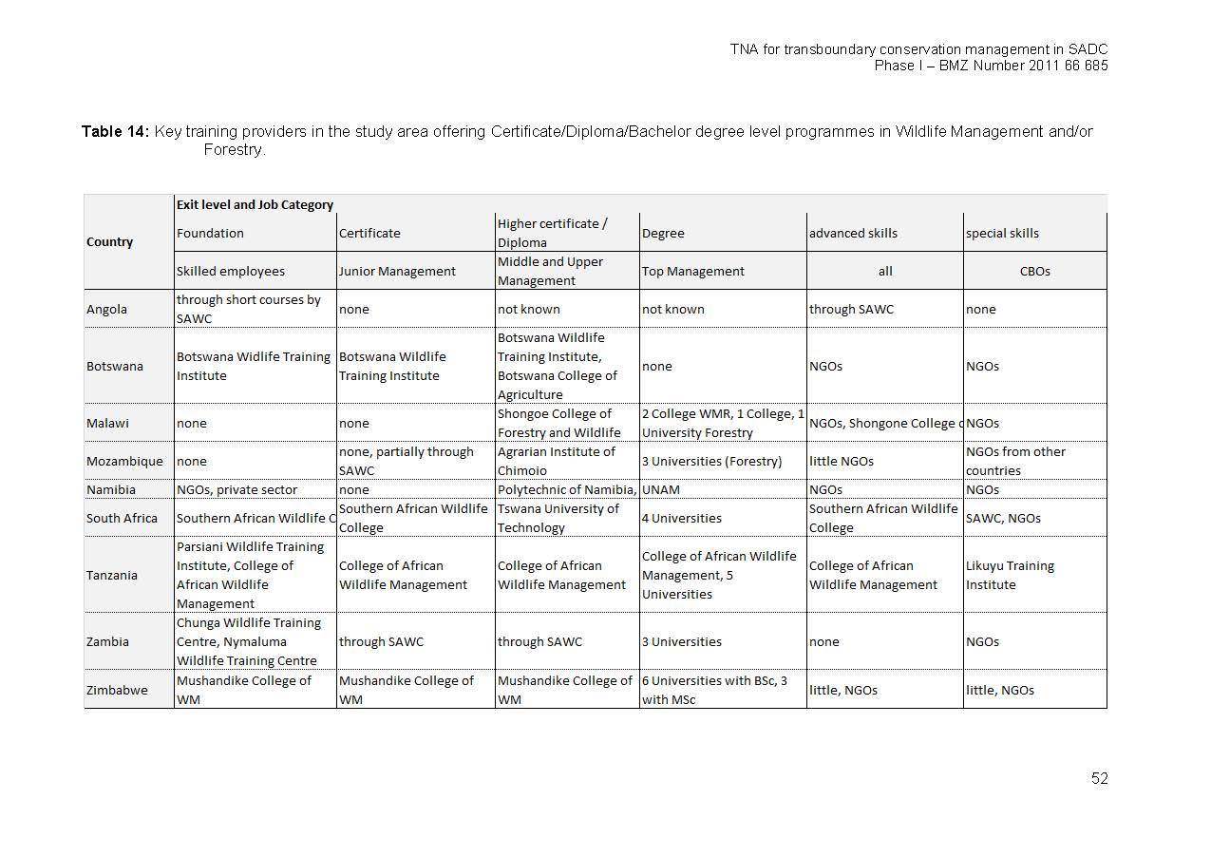
Institutions offering training for Wildlife Management (TNA Regional report, 2013)
Notes:
This is an overview from the Regional TNA report on the Training Institutions supporting various levels of training in the different countries for Wildlife Management.
It provides a snapshot of the current offering in this field and also where there are gaps.

Slide 6
Other Institutions offering training for TFCA careers
SA College of Tourism – Hospitality and Tourism careers
Wilderness Foundation (Umzi Wethu) - Hospitality
Universities(South Africa): University of Pretoria (MSc in TFCA), University of Free State, University of North West
Are there any other institutions left out?
Notes:
Besides Wildlife Management, there are various other topics of relevance in TFCAs (see presentation on Careers in TFCAs) and various other institutions offer training related to these topics.
e.g. SACT and Wilderness Foundation support capacity development in Hospitality and Tourism

Slide 7
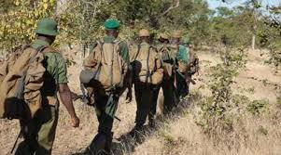
Ranger Training – Certificate level
Botswana Wildlife Training Institute (BW)
Southern African Wildlife College (SA)
Pasiansi Wildlife Training Institute (TZ)
Chunga Wildlife Training Centre (Zam)
Nyamaluma Wildlife Training Centre (Zam)
Mushandike College of Wildlife Management (Zim)
Are there any other institutions that we can add to the list?

Slide 8
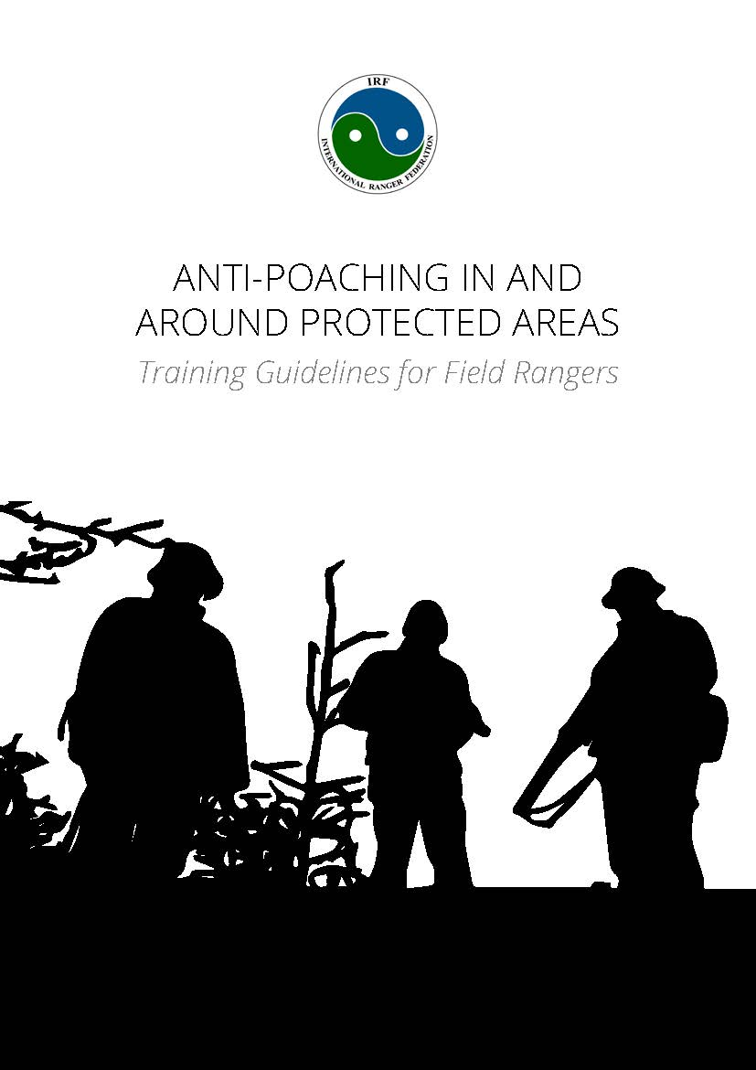
Ranger Training
Key content:
Offered by:
Duration:
Next intake:
Recognition:
Audience:
Cost:
Location:
Can we achieve standardised training across the region?

Slide 9
Subject | Recommended minimum time allotment
 | Theory | Practical
Values & ethics | 1 hour | Reinforced throughout training course
Concepts & principles of conservation and ecology | 8 hours | 4 hours
Criminal threats | 1 hour | Reinforced throughout training course
Roles & responsibilities | 1 hour | Reinforced throughout training course
Teamwork | 0.25 hour | Reinforced throughout training course
Operational security | 1 hour | 1 hour
Human rights | 1 hour | Reinforced throughout training course
Use of force | 1 hour | Reinforced throughout training course
Community collaboration | 2 hours | 2 hours
Drill & discipline | 2 hours | 0.5 hours per day
Weapon handling (elective)
Standard issue | 3 hours | 0.5 hours per day. Observed continually throughout training course
Specialist firearms | 1 hour | 1 hour per weapon system
Physical training | 1 hour | 1 hour per day
First aid
For field rangers | 12 hours | 12 hours & reinforced throughout training course
For team leaders | 20 hours | 20 hours & reinforced throughout training course
Survival skills | 8 hours | 8 hours & reinforced throughout training course
Equipment and maintenance | 1 hour | 2 hours & an additional 15 minutes per equipment item
Camouflage & concealment | 1 hour | 5 hours of which 1 hour is after dark
Radio communications | 1 hour | 1 hour per communication system & reinforced throughout training course
Hand signals | 1 hour | 1 hour & reinforced throughout training course
Orienteering & navigation | 8 hours | 8 hours & reinforced throughout training course
Tracking
Basic | 3 hours | 40 hours spread throughout the training course
Intermediate | 1 hour | 20 hours spread throughout the training course
Advanced | 1 hour | 20 hours spread throughout the training course
Wildlife protection legislation & court procedure | 8 hours | 2 hours
Evidence | 4 hours | 4 hours
Witnesses | 2 hours | 3 hours
Arresting procedures | 1.5 hours | 4.5 hours
Mission planning and orders | 1 hour | 2 hours
Marksmanship (elective) | 1 hour | Practiced throughout the training course
Immediate action drills (elective) | 1 hour | 4 hours & reinforced throughout training course
Suggested curriculum – Ranger Training

Slide 10
Patrols | 2 hours | 4 hours & reinforced throughout training course
Surveillance | 4 hours | 8 hours & an additional 1 hour for each spotting equipment
Rapid response to emergency situations (elective) | 1 hour | 4 hours
Searching & raids | Varying depending on applicable environment | 4 hours, however will vary depending on applicable environment
Vehicle checkpoints | 1 hour | 4 hours
Temporary bases | 1 hour | Reinforced throughout training course
Ambush | 1 hour | 5 hours during day and at night
Night operations | 1 hour | 6 hours & an additional 2 hours for each extra equipment item
Snaring & de-snaring | 2 hours | 2 hours with ongoing reinforcement throughout rest of training course; additional time may be required depending on the extent of snaring and types of snare used in the given area
Unexploded ordnance (elective) | 8 hours | 8 hours
Combatives | 0.5 hours focusing on safety | 24 hours, an additional 8 hours for inclusion of control & restraint, 8 hours for physical training, and 8 hours for self-defence
Standard operating procedures | 1 hour | 1 hour
Wildlife crime information | 2 hours | 2 hours
Basic crime scene response & photography | 3 hours | 4 hours
Basic identification of wildlife products | 2 hours | 3 hours
Interview & interrogate | 1 hour | 2 hours
Joint operations & cooperating with other law enforcement agencies | 1 hour | 0 hours
Waterborne operations (elective)
Crew | 3 hours | 5 hours
Coxswain | 16 hours | 24 hours
Aerial support (elective) | 1 hour | 3 hours
Pesticide crime & poisoning (elective) | 24 hours | 3 hours
Data collection | 2 hours | 2 hours & reinforced throughout training course; additional time needed if specialist data are collected
Debriefing & reports | 3 hours | 2 hours
Suggested curriculum – Ranger Training
(cont’d)

Slide 11
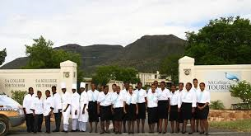


SA College of Tourism

Slide 12
Small Accommodation Establishments
Key content: Nationally accredited Culture Art Tourism Hospitality & Sport Sector Education and Training Authority (CATHSSETA) skills development training programme consisting of core modules, hospitality related generic subjects (computer skills, personal health & hygiene, occupational health & safety, guest relations, service and communication, etc.) and a Life Skills Module (Job Preparedness included), aimed at developing candidates at entry level in 4 areas of hospitality operations:
        Culinary skills (Assistant Chef)
        Food & Beverages (Table Attendant)
        Hospitality Operations (Assistant Housekeeper)
        Customer Service (Front of House Reception)
Offered by: SA College for Tourism
Duration: 11 months: Full-time (i.e . students accommodated on campus)
Next intake: January 2018 ; One intake per year – 3rd weekend in January each year
Recognition: Certificate: NQF level 2: 70 % practical/operational and 30% theory
Audience: The programme is aimed at newcomers to the hospitality industry who will work in one of the following jobs: Assistant Chef / Assistant Cook; Kitchen Cleaner / Laundry Assistant; Front of House Receptionist; Assistant Housekeeper; Table Attendant
Cost: R83 000-00 per student (transportation to and from college, all learning and assessment materials, al training equipment and uniform, stationery,fu ll board & lodging including laundering of uniform
Location: Graaff-Reinet – SA College for Tourism Campus; capacity to train 95 students annually - 30 places has been committed for 2018
Link: http://www.peaceparksfoundation.org/college.php?pid=28&mid=34

Slide 13
Hospitality Management
Key content: Combination of two CATHSSETA accredited qualifications, aimed at developing candidates who have completed the Skills Development Training Programme at entry level in 4 areas of hospitality operations:
        Culinary Art (Assistant Chef)
        Food & Beverages Services
        Hospitality Operations (Housekeeper)
        Customer Service (Front of House Reception)
Offered by: SA College for Tourism (SACT) in liaison with Drostdy Hotel , a wholly owned subsidiary of SACT
Duration: 12 months: Full-time
Next intake: One intake per year following completion of certificate at SACT
Recognition: Certificate: NQF level 4: Professional Cookery, Food and Beverage Services
Audience: Top 20 graduates of SACT who have successfully competed skills development training course at SACT Skills Programmes, preparing candidates for mid-management level positions
Cost: R60 000 per student per annum all inclusive including monthly stipend of R2 000
Location: Graaff-Reinet – Drostdy Hotel.
Link: http://www.peaceparksfoundation.org/college.php?pid=28&mid=34

Slide 14
Tracker Skills Programme
Key content: CATHSSETA accredited training programme endorsed by the Field Guides Association of Southern Africa (FGASA ) aimed at accurately identify relatively clearly defined spoor of small to large animals occurring in the area of operation and
systematically follow the spoor of a large ungulate (hooved mammal) under easy conditions. Identify the major living and
non-living features of the natural environment in which s/he operates and interpret them at a level based mainly on observation.
Offered by: SA College for Tourism Tracker Academy
Duration: 11 months: full-time
Next intake: Two intakes of 8 students per intake per annum– January and June with next intake June 2017
Recognition: Certificate: NQF level 2: Tracker and FGASA Tracker Level 1 - 4
Audience: The programme is aimed at training a new generation of 16 conservationists per annum who work in a conservation area in the following jobs:
        Tracker
        Game Ranger / Field Ranger
        Nature Guide /Animal Monitor/Anti –poaching operative
Cost: R110 00 per student all inclusive for 11 month sojourn at two campuses (5 and a half month each) in a semi-desert biome and a savanah/bushveld biome
Location: Eastern Cape (Samara Private Game Reserve) and Mpumalanga (Londolozi Game Reserve)
Link: http://www.peaceparksfoundation.org/college.php?pid=28&mid=34

Slide 15
Lead Tracker
Key content: Conduct fully accredited Recognition of Prior Learning Assessment on candidates who are already assumed competent and extensively experienced / skilled in the art of tracking and guiding. The RPL assessment will enable candidates to demonstrate their tracking and guiding skills:
          Accurately identify relatively moderate to difficult spoor of small to large animals occurring in the area of operation and systematically follow the spoor of a large ungulate (hooved mammal) under moderate to difficult conditions. This competence will enable the learner to track dangerous game in a guiding context, and track a variety of animals in a context of hunting, anti-poaching or research purposes.
          Identify the major living and non-living features of the natural environment in which s/he operates and interpret them at a level based mainly on observation.
Offered by: SA College for Tourism Tracker Academy
Duration: 8 Weeks
Next intake: One intake per year – date depends on availability / demand
Recognition: Certificate: NQF level 4: Lead Tracker
Audience: Candidates who are already assumed competent and extensively experienced / skilled in the art of tracking and guiding but without the necessary nationally accredited recognition of their skills .
Cost: R18 000 per trainee
Location: Mpumalanga (Singita Game Reserve)
  Link http://www.peaceparksfoundation.org/college.php?pid=28&mid=34

Slide 16
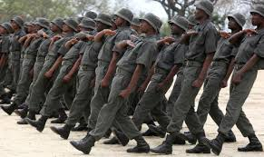
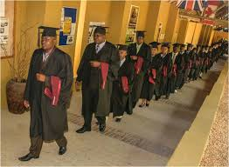


Southern African Wildlife College

Slide 17
Conservation Implementation and Leadership
Key content: Communication, Conservation Administration, Principles of Financial Administration, Computer Literacy, Philosophy & ethics of conservation, Basic Ecology, Vegetation studies, Animal studies, Principles of personnel Management, Community Development and conservation, Cultural Heritage Management, Environmental education, Introduction to Eco-tourism, Conservation Law enforcement, Infrastructure Maintenance, Conservation Management planning.
Offered by: SAWC
Duration: one academic year, direct student contact sessions = two College blocks, practical = 16 weeks in workplace
Next intake: January 2018
Recognition: Higher Certificate (Nature Conservation)
Audience: Potential protected area managers
Cost:
Location: SAWC campus and field sites
Link: www.wildlifecollege.org.za

Slide 18
Transfrontier Conservation Management
Key content: Financial Management, Human Resources Management, Eco Tourism, Environmental Development Planning, Land use planning, Geographical information systems in conservation, Transfrontier conservation, Natural Resources protection, CBNRM, Biodiversity Management, Catchment management, Resource economics,
Offered by: SAWC
Duration: one academic year, direct student contact sessions = two College blocks, practical = 16 weeks in the workplace
Next intake: January 2018
Recognition: Advanced Certificate (Nature Conservation)
Audience: Potential protected area managers
Cost:
Location: SAWC campus and field sites
Link: www.wildlifecollege.org.za

Slide 19
Dangerous Game Site Guide
Key content: Creating guiding experience, Geology, Astronomy, Weather and climate, ecology, taxonomy, biomes, botany, arthropods, amphibians, reptiles, fish, birds, mammals, animal behaviour, conservation management and history, tracking, wildlife diseases, viewing potentially dangerous animals, handling firearms.
Offered by: SAWC
Duration: 75 days
Next intake:
Recognition:
Audience: Entry level people with and interest in nature guiding, field rangers
Cost:
Location: SAWC
Link: www.wildlifecollege.org.za

Slide 20
Professional Hunting
Key content: Effective communication, analyse information, statistics, maths, ethics, legislation, animal sizes (trophy size), animal behaviour, firearm handling, tracking, guiding, processing trophies for dispatch
Offered by: SAWC
Duration: 2 years, 18 months on site, 6 months practical
Next intake:
Recognition: FET Certificate
Audience: individuals interested in Professional Hunting (older than 22, good physical and mental stamina, good communication skills)
Cost:
Location: SAWC (on site), Employer (practical)
Link: www.wildlifecollege.org.za

Slide 21
Natural Resource Management
Key content: Conservation ethics, manage area integrity, compliance and enforcement, legislation, PA planning, plant management, wildlife management, integrated catchment management, cultural heritage, infrastructure, soil erosion, manage teams, communication
Offered by: SAWC
Duration: one academic year
Next intake: Jan 2018
Recognition: National Certificate
Audience: Aspirant protected area and natural resource managers. Current field staff, e.g. field rangers, general assistants, supervisors and junior managers
Cost:
Location: SAWC
Link: www.wildlifecollege.org.za

Slide 22
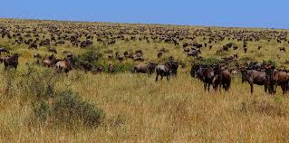
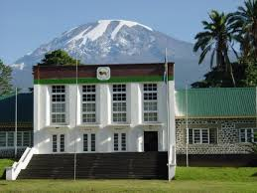
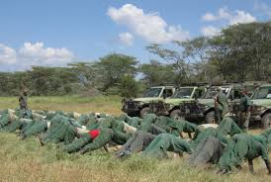


Mweka College of African Wildlife Management

Slide 23
Ecotourism Planning and Management
Key content: Ecotourism, Nature-based tourism, Destination Management, Tourism, Tourism Planning
Offered by: College of African Wildlife Management, Mweka
Duration: Three weeks full time
Next intake: August, November
Recognition: Certificate of Achievement
Audience: Protected Area Managers, Tourism Officers, Tourism Investors
Cost: 1500US$
Location: Mweka, Moshi – Tanzania
Link: www.mwekawildlife.ac.tz

Slide 24
Bachelor Degree in Wildlife Management
Key content: Wildlife Management, Biodiversity Assessments, Protected Area Planning, Protected Area Management
Offered by: College of African Wildlife Management, Mweka
Duration: Three Years Full Time, 5 Years Part Time
Next intake: October 2017
Recognition: Bachelor Degree
Audience: PA Managers/Wardens, Game Ranchers
Cost: <indicate cost for the course>
Location: Mweka, Moshi – Tanzania
Link: www.mwekawildlife.ac.tz

Slide 25
Bachelor Degree in Wildlife Tourism
Key content: Nature-Based Tourism Management, Tourism Planning, Destination Marketing and Management,
Offered by: College of African Wildlife Management, Mweka
Duration: Three Years Full Time, 5 Years Part Time
Next intake: October 2017
Recognition: Bachelor Degree
Audience: PA Managers/Wardens, Tourism Enterpreneurs
Cost: <indicate cost for the course>
Location: Mweka, Moshi – Tanzania
Link: www.mwekawildlife.ac.tz

Slide 26
Ordinary Diploma – Wildlife Management
Key content: Wildlife Management, Biodiversity Assessments, Protected Area Planning, Protected Area Management, Wildlife Law-enforcement, Patrol Skills
Offered by: College of African Wildlife Management, Mweka
Duration: Two Years Full Time, 5 Years Part Time
Next intake: August 2017
Recognition: Diploma
Audience: PA Rangers/Wardens, Tourism Officers, Tour guides, Community Based PA/Tourism Officers, Game Scouts
Cost: <indicate cost for the course>
Location: Mweka, Moshi – Tanzania
Link: www.mwekawildlife.ac.tz

Slide 27
Ordinary Diploma – Wildlife Tourism
Key content: Wildlife Tourism, Customer Care, Guiding, Resource Interpretation,
Offered by: College of African Wildlife Management, Mweka
Duration: Two Years Full Time, 5 Years Part Time
Next intake: August 2017
Recognition: Diploma
Audience: PA Rangers/Wardens, Game Ranchers, Community Based PA Officers, Game Scouts
Cost: <indicate cost for the course>
Location: Mweka, Moshi – Tanzania
Link: www.mwekawildlife.ac.tz

Slide 28
Basic Certificate in Wildlife Management
Key content: Wildlife Management, Resource Identification, Ecological Data Collection, Paramilitary Techniques, Law enforcement, Anti Poaching Techniques
Offered by: College of African Wildlife Management, Mweka
Duration: One Year Full Time, 3Years Part Time
Next intake: August 2017
Recognition: Basic Certificate
Audience: Game Scouts, Wildlife Rangers, Game Ranch Employees
Location: Mweka, Moshi – Tanzania
Link: www.mwekawildlife.ac.tz

Slide 29
Basic Certificate in Wildlife Tourism
Key content: Wildlife Tourism, Resource Interpretation, Tour Guiding, Paramilitary Techniques, Customer Care
Offered by: College of African Wildlife Management, Mweka
Duration: One Year Full Time, 3Years Part Time
Next intake: August 2017
Recognition: Basic Certificate
Audience: Game Scouts, Tour Guides, Game Ranch Employees
Location: Mweka, Moshi – Tanzania
Link: www.mwekawildlife.ac.tz

Slide 30
Regular Short courses offered at CAWM.
Price, duration and when next offered available on demand
Tropical Ecology and Conservation
Conservation action planning and financial reporting for CBNRM
Wildlife Inventory and monitoring for CBNRM
Tour Guiding and Interpretation
Professional Walking Safari
GIS for Conservation
Natural Resources Entrepreneurship
Ecological Monitoring in Protected Areas
Natural Resources Policies and Procedures for CBNRM
Wildlife Tourism Management
Applied Firearms in Wildlife Management
Destination Management for Wildlife Areas
Cultural Tourism Promotion and Management
Principles of Protected Area Planning
Plants Identification and Herbarium Techniques
Birds Identification and Interpretation
Governance in Natural Resources Management

Slide 31


Mushandike College of
Wildlife Management

Slide 32
About Mushandike College
Mushandike College of Wildlife Management, is a college wholly owned by Parks and Wildlife Management Authority in the Ministry of Environment, Water and Climate
It is duly registered with the Ministry of Higher and Tertiary Education, Science and Technology development as a Government Technical and Vocational Education and Training (TVET) institution in terms of Zimbabwe Manpower Planning and Development Act Chapter 28:02 of 1996 as revised in 2003.
The college is a registered Higher Examinations Council (HEXCO) examination centre.
Mushandike College is an affiliate institution of National University of Science and Technology (NUST).

Slide 33

Food for thought……..

Slide 34
What Does Mushandike College Offer?
Courses | Duration | Level | Accreditation Status
Wildlife Management (HEXCO | One year | NFC | Accredited
Accountancy (HEXCO) | One year | National Certificate | Accredited
Wildlife Management (HEXCO) | One year | National Certificate | Accredited
Information Technology (HEXCO) | One year | National Certificate | Accredited
Accountancy (HEXCO) | Two years | National Diploma | Accredited
Wildlife Management (HEXCO) | Two years | National Diploma | Accredited
Information Technology (HEXCO) | Two years | National Diploma | Accredited
Wildlife Management (HEXCO) | One & Half years | HND | Accredited
BSc (hons) Wildlife and Protected Area Management in partnership with NUST. | 4 years for A levels and 2 years for HND holders | A level Biology/Agriculture. Or HND wildlife management | Affiliated to National University of Science and Technology (NUST), Zimbabwe

