Slide 1
Training Needs assessment for Wildlife Managers and Rangers for TFCAs in the SADC Region
A planning study for SADC financed by the Federal Republic of Germany through KfW.
Preliminary Results of the Study

Slide 2
Content
Background of the negotiations leading to TNA
Frameworks for TNA
Methodology
Gaps identified
Proposed funding framework

Slide 3
Scope and purpose of the mission
German financial cooperation with SADC: Funding of 3 TFCAs
Intergovernmental negotiations on Training Needs: 4 million for SAWC + 6 million to support training for WMRs in GC funded TFCAs in SADC
Purpose of study: assess quantitative and qualitative gaps for training of WMRs
Study area: the countries constituting the 3 TFCAs plus the countries hosting the regional centres of excellence

Slide 4
Scope and purpose of the mission: Policy and legal framework
SADC protocols on:
  Wildlife Conservation and Law Enforcement
  Forestry
  Education and Training
SADC Programs on:
  TFCA development
  REDD+
  Forestry
TFCA MoUs (7) and Treaties (4)

Slide 5
Methodology: Representativeness of assessments
10 SADC MCs were assessed hosting 16 out of 17 TFCAs in the SADC region

Slide 6
Methodology: Representativeness of assessments and accociated process
Staff ≠ Staff
Training ≠ Training
Country visits and stakeholder meetings: 7 regional and international Consultants in July and August 2012
Review and feedback on country level: all draft country assessments between September and October 2012
Review on regional level: patterns and similarities; categorization of training; standardisation for quantification in September 2012
Regional synergy assessment: October – November 2012
  Process management in conservation
  Paterson level of work
  Data analysis and model calculations
  Coordination between KfW, GIZ and WWF November and December 2012
Review and feedback on regional level:
  BMZ: January 2013
  SADC: February 2013

Slide 7
Training ≠ Training: key processes of conservation management and associated training requirements
Steering processes
TFCA stakeholder engagement
Policy formulation & harmonisation
Strategy development
Budgeting & funding
organisational processes & structures
Core processes
Input
outputs
Stakeholder engagement & community outreach
Stable / increased numbers in protected key species
Sustainable ecological and socio-economic functions of habitat and resources
Mechanisms for sustainable resource utilisation
Increased income for rural population
Decreased human-wildlife conflicts
Staff
Infrastructure
Equipment
Operational funding
Investments
Wildlife management
Protection & law enforcement
Co-Management of forests, water, land across boundaries
Monitoring & Evaluation
Budgeting & Planning for PAs
Human resources development
Spatial Planning
Technical audits for PAs
Support processes

Slide 8
Staff ≠ Staff: Paterson levels of work for WMRs and numbers of related sectors
~ 10,000 persons WMR government staff:
90% in Junior Management
10% in Middle Management
1% in Top Management
~ 10,500 Forestry staff + staff from local government, land use, law enforcement etc.
~ 10,000 persons CBO related support

Slide 9
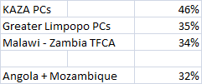
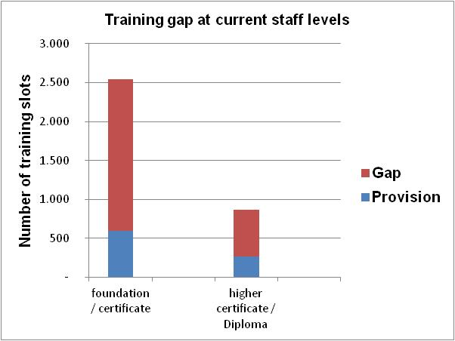
Training Needs:
Quantitative Gap for formal qualifications of WMR staff
+ 5,000 for new positions
% share in the training gap
+ 400 for new positions
2,500
At current staff levels only 30% of training required is delivered.
At future staff levels less than 15% of training required is delivered.
Estimations refer to the least minimum.
650

Slide 10
Training Needs:
Quantitative Gap for short course requirements
WMR government staff:
30% of staff trained; 1 course/person; no data available on current capacity
> 3,000 courses annually at current staff levels
+ 3,000 courses annually at future staff levels
CBO staff:
20% of staff trained; 1 course/person; no data available on current capacity
> 5,000 courses annually at current staff levels
+ > 10,000 foundation training for future staff levels
+ > 5,000 courses annually at future staff levels

Slide 11
Training needs: quantitative gap
Biggest beneficiary groups in need of training are:
  Junior Managers, skilled and semi-skilled employees
  CBO Managers and CBO game scouts
  Staff in lusophone countries, especially Middle and Junior Management category
Biggest numerical gaps in training slots are:
  Foundation certificates
  Lusophone courses (certificate and short courses)
  Short courses (refresher training, specialised training, in-field training)
  CBO Training

Slide 12
Qualitative training gap: Training requirements for governmental staff and CBO staff – across all countries and staff levels
Factual knowledge
Steering processes
Strategic knowledge on processes, organisations, topics
Experiential knowledge
TFCA stakeholder engagement
Policy formulation & harmonisation
Strategy development
Budgeting & funding
organisational processes
Core processes
Work related knowledge
Stakeholder engagement & community outreach
Wildlife management
Protection & law enforcement
Analytical & conceptual skills
Leadership
Communication
Co-Management of forests, water, land across boundaries
Monitoring & Evaluation
Budgeting & Planning
Human resources development
Spatial Planning
Technical audits for PAs
Skills
Support processes

Slide 13
Options to address the quantitative and qualitative training gap
A system approach is required on regional and sub-regional level
Trainer capacity
Infrastructure
Course design
Increase throughput of TIs
Funding
Training provision
Training demand
Task oriented needs assessment
Promote demand orientation
Improve work integration
HR strategy

Slide 14
The proposed funding framework....is work in progress... is a tool for the SADC secretariat and MCs
  Purpose:
  Tool for coordination
  A jointly agreed framework amongst SADC MCs to support capacity development for NRM in TFCAs
  A tool to address training needs simultaneously through regional and national measures
  A framework to “speak the same language” as a community and with development partners
  Tool for guidance of development partners
  Identification of priority area, type of support and geographic location
  Identification of complementarities with other funding sources
  Identification of funding gaps

Slide 15
Proposed funding framework
To close the quantitative & qualitative training gap for wildlife managers and rangers working in conservation areas, especially those being a constituting part of a TFCA in order to....
To support the development of an integrated network of cross- border key ecological areas to conserve biodiversity and ecosystem services, and foster economic and social development, regional integration and stability in the SADC region.
The staffs of park administrations, related governmental agencies and local administrations apply adequate and up to date skills to manage TFCA related conservation areas effectively and efficiently in collaboration with neighbours.
Core problem to be addressed
Overall development goal = TFCA program goal
Proposed objective for funding framework

Slide 16
Proposed funding framework – see handout for details
Training and mentoring systems for junior staff & job entrants
Peer based learning systems and help desks for all WMR levels
1. Adequate equipment and infrastructure for work integrated training of WMRs
3. The efficiency, effectiveness and throughput of existing Training Institutions is enhanced
2. Continuous support systems are established to provide work place related knowledge on demand
4. Work place skills needed to ensure core functions of TFCA management are provided to WMRs, CBOs and staff from related sectors
Field training units & field training venues
Set up, implementation and management support
Systems for needs driven continuous adaptation and update of curricula, including performance based assessments
Work oriented qualification on managing complex processes and strategy implementation
Develop Funding mechanisms
Invest into Training of Trainer System
Elaborate business plans for TIs operating below capacity and redesign infrastructure
Upgrade infrastructure and equipment of TIs operating at full capacity
Build up appropriate training provision for lusophone countries, including curricula and trainers
Qualify and upgrade junior and middle management staff in lusophone countries
Implement training and update curricula on priority topics for all managerial levels

Slide 17
Proposed funding framework – see handout for details
  Estimated needs for funding
  Infrastructure:
    > 25 million € for upgrade, rehabilitation and redesign of existing Training Institutions
    ? million € to be specified for field training venues
  Equipment:
    ? million € to be specified for field training
    ? million € to be specified for upgrade of TIs (class rooms, dormitories, basic services)
  Training of staff :
    > 20 million € minimum estimation to close current and future training gap of WMR staff government + CBO
    ? Million € annually to maintain staff and qualification levels
  Advisory services and planning: to be specified
  Estimated available funding
  Regional Cooperation:
    ~ 16 million € BMZ + ~ 15 million € IUCN/EU
  Bilateral Cooperation:
    ~ 45 million € BMZ and WWF

Slide 18
Criteria for the selection of a funding window for the 10 million € SADC – Germany financial cooperation
  General criteria for identification of project
  Duration 3 – 5 years
  Complementary with interventions from a) other donors and b) interventions to support conservation management in established TFCAs
  Self contained impact, i.e. The absence of other interventions does not lead to reduced success of the intervention
  Specific criteria for selection of measures
  Geographic priority = hot spot of threats & opportunities in TFCAs; clear trans-frontier context
  Established institutional set-up
  Direct contribution to closing a training gap
  Promotion of sub-regional training approach

