Slide 1
Feasibility for Training of Wildlife Managers and Rangers for NRM of TFCAs in the SADC Region, Phase 2
A planning study for SADC financed by the Federal Republic of Germany through KfW.
Preliminary Results of Phase 2
12.6.2013 BMZ, Referat 305, Bonn, Germany

Slide 2
Content
Justification and purpose of the program co-funded with 10 mio € through KfW
Overall concept
Draft logframe
Draft layout scholarship fund
Draft layout infrastructure fund
Draft budget outline
Options for institutional set up of the program

Slide 3
1. Justification and purpose of the programme
Junior Managers and Rangers are the biggest stakeholder group in need of training
Within this group staff from lusophone countries is especially in need of training as well as training material for lusophone countries
Skills based in-field training is needed to train specific skills required for transboundary conservation management at the operational level
Emphasis has to be given to the sustainability and applicability of the training input
CBOs require a specific approach

Slide 4
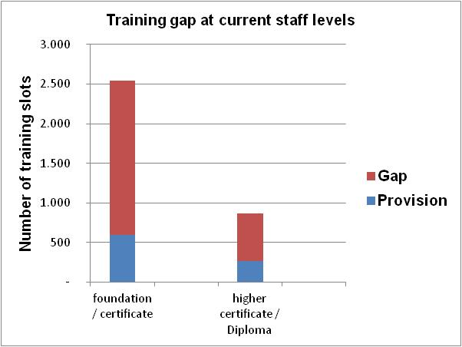
1. Justification and purpose of the programme: Quantitative gap
+ 5,000 for new positions
At current staff levels only 30% of training required is delivered.
At future staff levels less than 15% of training required is delivered.
Estimations refer to the least minimum.
+ 400 for new positions

Slide 5
1. Justification and purpose of the programme: Qualitative gap
Factual knowledge
Strategic knowledge on processes, organisations, topics
Experiential knowledge
Steering processes
TFCA stakeholder engagement
Policy formulation & harmonisation
Strategy development
Budgeting & funding
organisational processes
Work related knowledge
Core processes
Stakeholder engagement & community outreach
Wildlife management
Analytical & conceptual skills
Leadership
Communication
Protection & law enforcement
Co-Management of forests, water, land across boundaries
Skills
Monitoring & Evaluation
Budgeting & Planning
Human resources development
Spatial Planning
Technical audits for PAs
Support processes

Slide 6
2. Overall concept: Options to address the training gap
Trainer capacity
Infrastructure
Course design
Increase throughput of TIs
Funding
Training provision
Training demand
Task oriented needs assessment
Promote demand orientation
Improve work integration
HR strategy

Slide 7
2. Overall concept: Programme design
Three pillar approach:
  Infrastructure and capacity development of regional centre of excellence, SAWC
  Infrastructure and equipment to enhance capacity of in-field training at the workplace
  Scholarship fund with co funding from governments, ICPs and private sector to provide training to WMRs for transboundary management of critical ecosystems functions and key species in specific conservation areas
Accompanying measures for program management & management of the scholarship and infrastructure fund
Phase I of the programme to focus on:
    Category A TFCA-PCs
    WMR teams working in conservation areas which are important to protect the integrity of TFCAs
    TFCAs-PCs receiving funding under the German financial cooperation

Slide 8
2. Overall concept: Expected output TNA study phase II
Overall programme concept, logframe and budget, institutional set-up
Elaborate investment planning for the amount of 4 million € which was earmarked to SAWC and concept how SAWC will contribute to the achievement of a sub-regional training approach.
Elaborate a framework for a scholarship-fund.
Develop and validate a model for field-based training Infrastructure and prepare cost estimation for this model
Propose organisation and set up of infrastructure facility

Slide 9
3. Draft Logframe
Overall Goal:
To support the development and management of established TFCAs in the SADC region, in order to joint fragmented wildlife habitat across international boundaries in which wildlife is efficiently managed, biodiversity maintained, and where the socio-economic conditions of the rural communities are enhanced through eco- and cultural tourism development and sustainable use of natural resources.
Indicators of program contributing to overall goal:
Assessment of park management using the Management effectiveness Tracking Tool (METT score card)
Decrease of poaching of key species
Development of income to communities from utilization of wildlife resources
% of positions of WMRs filled with appropriately qualified staff

Slide 10
3. Draft Logframe
Outcome:
Wildlife managers and rangers (WMRs) are trained to apply workplace related skills and up-to date knowledge to manage critical ecosystems functions and key species across boundaries.
Indicators:
% of wildlife managers and rangers in a specific conservation area with workplace related skills and up-to date knowledge
% of programme completers working in relevant occupations over a period of 24 months at a specific conservation area
% of employees who, within a period of 24 months, consider the programme useful
% of employers who are satisfied with program completers

Slide 11
3. Draft Logframe
Outputs
WMR teams of selected conservation areas have nearby access to in-field training venues and appropriate equipment for workplace related and cost-efficient training on transboundary conservation management.
Training Institutions benefit from adequate infrastructure development to improve the provision of workplace related training (quantity, effectiveness and efficiency).
  Infrastructure development SAWC
  Business plan elaboration for selected Training Institutions
  In-field training concepts and related infrastructure planning
A mechanism is established to finance and provide needs driven, workplace related training to WMR teams of specific conservation areas for transboundary conservation management.
  Development of training programmes for teams in specific conservation areas
  Scholarship fund
  M&E system
An efficient and effective programme management is established and functional.

Slide 12
4. Draft layout scholarship funding
Who benefits:
  Employed teams in specific conservation areas, which are important to protect the integrity of the TFCA
  Batches of 20 – 25, across ranks, operational level (up to section ranger / warden)
What is funded:
  Skills and knowledge to maintain critical ecosystems functions and key species, 1st priorities: anti-poaching, community outreach, spatial planning and management other priorities based on justification
  Foundation training, refresher training, innovation training, leadership training, training of trainers and mentors
  2 – 3 years training programs for team development up to 25.000 € per 25 trainees
  Equipment required for training and subsequent work application up to 60.000 € per 25 trainees

Slide 13
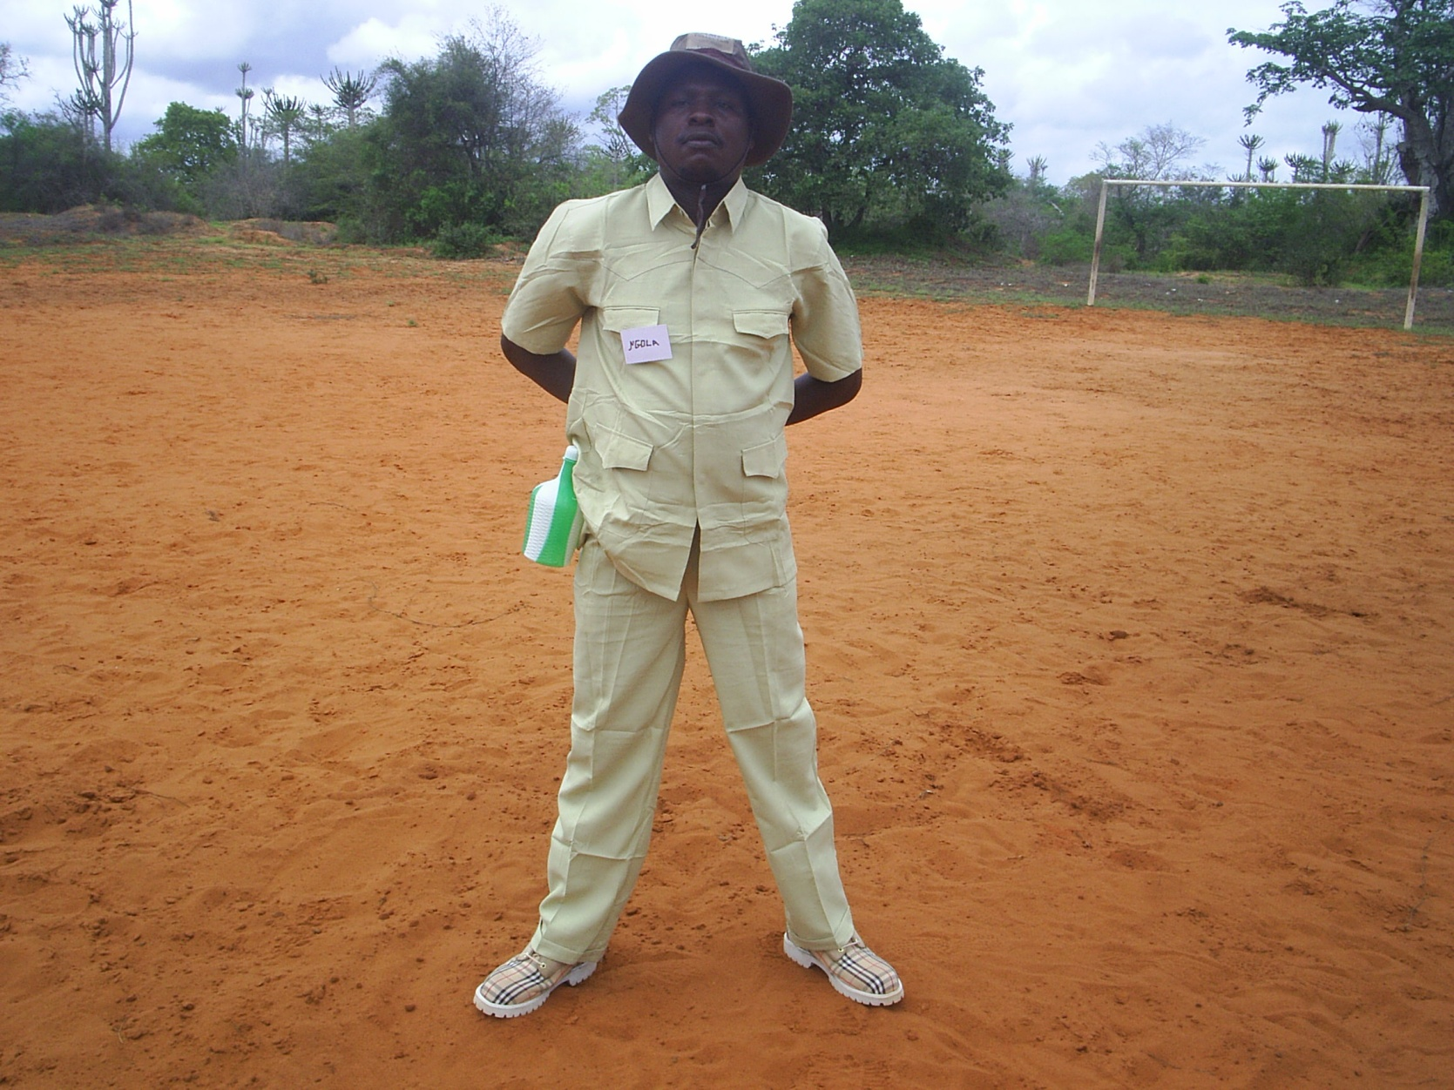
4. Draft layout scholarship funding:
Equipment / Copyright: R. De Kock

Slide 14
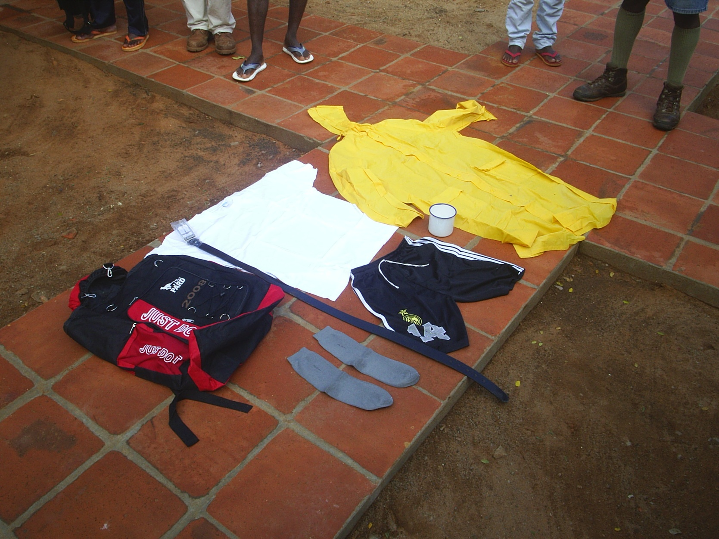
4. Draft layout scholarship funding:
Equipment / Copyright: R. De Kock

Slide 15
4. Draft layout scholarship funding
Implementation principles:
  Tripartite agreement between Training Institution (TI), Employer, Park Management
  Letter of undertaking from the Employer that at least 70% of the trained team members remain at the workplace in a particular conservation area for a minimum of 2 years after the end of the training programme, employee to confirm his personal commitment
  Training programs developed by TI together with Park Management and in line with workplace conditions
  Implementation risks :
    Nepotism: it has to be ensured that training is provided to the “right” people
    Formalism: the training provided has to respond to the actual skills gap and the potential of trainees
    Inefficiency: it has to be ensured that funds disbursed to training institutions (TI) are used without delay for training implementation at the lowest possible administrative costs
    Bad quality: it has to be ensured that unqualified training providers (body shops) are safely excluded

Slide 16
4. Draft layout scholarship funding
    Risk mitigation measures:
    Applications based on skills audits of teams in specific conservation areas by the TI in close collaboration with the Park Manager and Director; check attitude, skills and potential of staff versus actual job requirements in the workplace (1-2 day assessments on site)
    Recognition of prior learning and skills based assessments (address NQF levels 2 – 5)
    Application based on training programs elaborated by TI for teams in specific conservation areas with endorsement from employer
    Evaluation of applications based on agreed good practice of foundations skills training for WMRs
    Training offered is based on accredited curricula which are adjusted to actual needs
    Undertake pre-qualification of TIs in the SADC region and establish data base of eligible TIs
    Manage funds by experienced and professional fund manager with respective accountability attached
    Establish real-time financial and technical reporting on progress which is a pre-condition for disbursement
    Undertake external financial audits and technical quality control

Slide 17
5. Draft layout infrastructure funding
Who benefits:
  Applications can be joint venture (including GOs, NGOs, TI’s, Universities, CBOs, private sector)
What is funded:
  Field training venue infrastructure with durable kitchen, sanitary blocks and class-room, tented camp for up to 50 students and instructor
  Up to 300.000 € per infrastructure
  Equipment in connection to training programs

Slide 18
5. Draft layout infrastructure funding
Implementation principles:
  Must have management & maintenance plan
  Have to be supported by the lead wildlife management agency in the respective country
  Must show significance to transboundary conservation management
  maintenance and management costs to be funded by hosting institution
    Implementation Risks:
    Management and maintenance costs are not covered sustainably
    Costs per trainee are too high due to low occupancy rate

Slide 19
5. Draft layout infrastructure funding
    Risk mitigation:
  Justification of location:
    Does it reduce travel time of WMRs?
    Is it located in close proximity to ongoing training programmes?
    Is the location accessible all year round?
    Other relevant factors? – biodiversity, anti-poaching considerations
    Will it be used by several stakeholders for training?
    Is it easy to service, to lock up - could it be attached to bigger structures to save on costs for basic service supply (electricity and water?)
    How will food be provided?
    Sound assessment of expected cost/trainee to use the location prior to construction
    Price for accommodation and use of venue must include administration and managerial expenses and must be competitive
    Check if venue can be (co-) managed by TI or hospitality business who do have an experience track record in accommodation management and maintenance

Slide 20
6. Draft budget outline: Costs
Costs (rough estimation only)
Infrastructure & equipment for workplace related training
  1,25 million €
  0,4 million € equipment for trainees
Adequate infrastructure development for training institutions
  4,0 million € expansion of SAWC
  0,3 million € business plans, concepts and curricula
A mechanism is established to finance and provide needs driven, workplace related training
  2,1 million € Training courses (including skills audits and training programmes) for up to 1.900 trainees
  0,5 million € management of scholarship fund
Implementation and Programme Management
  0,9 million technical assistance & support staff
  0,2 mio € office & equipment
  0,35 mio travel and workshops
  Grand total: ca. 10 million €

Slide 21
6. Draft budget outline: Costs
Costs (rough estimation only) Investment SAWC
  Sub-total : ca. 4 million €
  53% trainer accommodation, office space and additional training facilities
  5% IT upgrade, signage, road network Campus
  8% basic services infrastructure
  14% energy and water saving measures
  20% EIAs, contractor & architect fees; site management and contingencies

Slide 22
6. Draft budget outline: Financing
  Financing:
  10 million € by BMZ through KfW
  Co-funding from governments would increase the number of trainees and decrease admin & consultant costs/trainee
  Additional co-funding through fund raising activities by TIs and NGOs
  Other potential donors to be identified

Slide 23
7. Institutional set up of the programme
Main bottlenecks to successful project implementation:
  Time required for release of finances
  Time required for decision making and approvals
  Procurement management
  Communication with Member States

Slide 24
7. Institutional set up of the programme: Scenario 1
Program management integrated completely into SADC procedures and regulations:
  Hire project staff: Coordinator; Finance officer ; M&E officer
  Call on short term experts as required
  Follow SADC procedures
    Includes communication lines (letters to MS have to be signed by Director/ES)
    Procurement for project (follow SADC procedures)
    Financial release (Director FANR and Finance is co-signatory)
    Contracts are signed by Director FANR
    TORs for tenders have to be approved by SADC Senior Programme Officer and Director

Slide 25
7. Institutional set up of the programme: Scenario 2
Co-management:
  Project staff recruited by tendering out for a consultancy to provide:
    Coordinator
    Support staff
    Short-term expertise
  Coordinator does the procurement independently based on SADC approved procurement plans, and TORs for short term expert missions (approved at the beginning of the year)
  Coordinator ensures KfW compliant implementation of infrastructure fund
  Separate account is co-signed by SADC Finance (or other) and Coordinator
  Communication lines with MS delegated to Senior Programme Officer and Coordinator (up to Director level in MS)

Slide 26
7. Institutional set up of the programme: Scenario 3
  Supervision by SADC, Channelling Agreement
  To SAWC
  To Implementing Agent, to be identified through tender
  SADC convenes project steering committee (e.g. Senior Programme Officer, Finance person, Ed & Skills Development Senior Programme Officer, TFCA TA). This PSC must have full decision making authority. Possible?
  Beginning of each year, Implementing Agent submits:
    Annual budget and work plan
    Short term expert input scheduled
    Procurement plan
  Half yearly review by steering committee, any major changes to be approved by PSC.
  Half yearly post expenditure audits (1 auditing contract for the full period of the project)

Slide 27
7. Institutional set up of the programme: Scholarship & infrastructure funding
  Management of Scholarship and infrastructure funding
  SADC has experience with the management of research funds and MSc scholarship funds
  SADC also states that financial management and M&E are a major challenge and require additional staff as well as travel resources
  DBSA and other funds in SA use web-based reporting systems to administer scholarship funds. Submission of complete report is a pre-condition for disbursements – reports serve as M&E data base
  However, the PPTF case shows that disbursement of funding and application procedures can be too slow for implementation
  Specialized NGOs and companies for fund management do exist in the sub-region
  Channelling agreement and accountability of third party was preferred option in discussions
  To save costs scholarship fund and infrastructure fund should be managed by the same entity
  To save costs too many tenders should be avoided

Slide 28
7. Conclusions of discussion: programme set up and scope
  Programme set up and scope
  The preferred option is a channelling agreement between SADC & KfW (scenario 3)
  A Consultant / Implementing Agent should be recruited via tender to manage the programme, the scholarship budget line and the infrastructure budget line on behalf of SADC and KfW (Fiscal Agent model with technical responsibility)
  Eligibility criteria for funding of training and infrastructure should be fixed in the Separate Agreement. They should represent clear benchmarks in order to focus the spending of the 10 million.
  The funding focus is on training measures for transboundary conservation management on the operational level, which does not exclude measures to upgrade teams to a comparable level of knowledge and skills on both sides of the international borders.
  The beneficiary groups are teams of wildlife managers and rangers stationed in conservation areas with a direct management link to cross-border conservation areas. Members of CBOs benefit in as far as they form a part of such teams.
  Priority is given to:
    Teams working in conservation areas which do have a direct cross-border link
    Category A TFCA
    Partner Countries in which at least 20% of the total terrestrial conservation area do constitute a part of a TFCA.
    Proposed training programmes which do show a clear link between the training objective and cross-border conservation management activities

Slide 29
7. Conclusions of discussion: scholarship and infrastructure funding
  Scholarship and infrastructure funding
  It was clarified that the “scholarship fund” and the “infrastructure fund” are better designated as “budget lines” because their purpose is to provide funding for training rather than establishing a fund.
  For the purpose of efficiency and effectiveness the scholarship budget line and the infrastructure budget line should be managed in line with programme implementation through the same entity on behalf of the SADC Secretariat (see above)
  Infrastructure development and equipment procurement need to be closely integrated with training measures and actual work place conditions
  Concern was expressed on time required until the first training can be delivered.
  On the other hand it was requested that the mechanisms for funding of infrastructure and trailing should be established sustainably. For this purpose the corresponding processes & procedures will have to be established with SADC (accompanying measures). Thereby SADC will be enabled to maintain processes & procedures independently from the Implementing Agent (good practice example MCC fiscal agent contracting). However, this might slow down implementation speed (see above)
  Preference was given to a competitive application process. However, concern was expressed that the number of competent training providers might not be sufficient and that capacity of national TIs is to weak to submit competitive applications.

Slide 30
7. Conclusions of discussion: Transboundary relevant training
  Transboundary relevant training
  According to the results of TNA I, transboundary relevant training for the operational level does primarily require specific training methodologies to improve transboundary conservation management. It furthermore requires the transfer of specific skills (e.g. communication, foresight, planning).
  GIZ will fund to pilot trainings to test and develop methodologies for transboundary training by mobile training units with SAWC and other TIs. Furthermore GIZ could fund Training for Trainers as well as knowledge exchange between Training Institutions
  It is assumed that SAWC as a regional centre of excellence will progressively integrate transboundary relevant themes and methods into existing curricula and will also provide knowledge transfer to national Training Institutions for transboundary training
  Under the financial cooperation priority should be given to fund training which ensures that teams on two sides of an international border do have comparable knowledge, skills, understanding and terminology in conservation management so that activities in conservation management become compatible
  Training should preferably be carried out in such a way that teams from both sides of a border are jointly trained.

Slide 31
Thank you for your attention!

