Slide 1
SADC TFCA Network – an overview Tawanda Gotosa – TFCA Technical Adviser SADC Secretariat

Slide 2
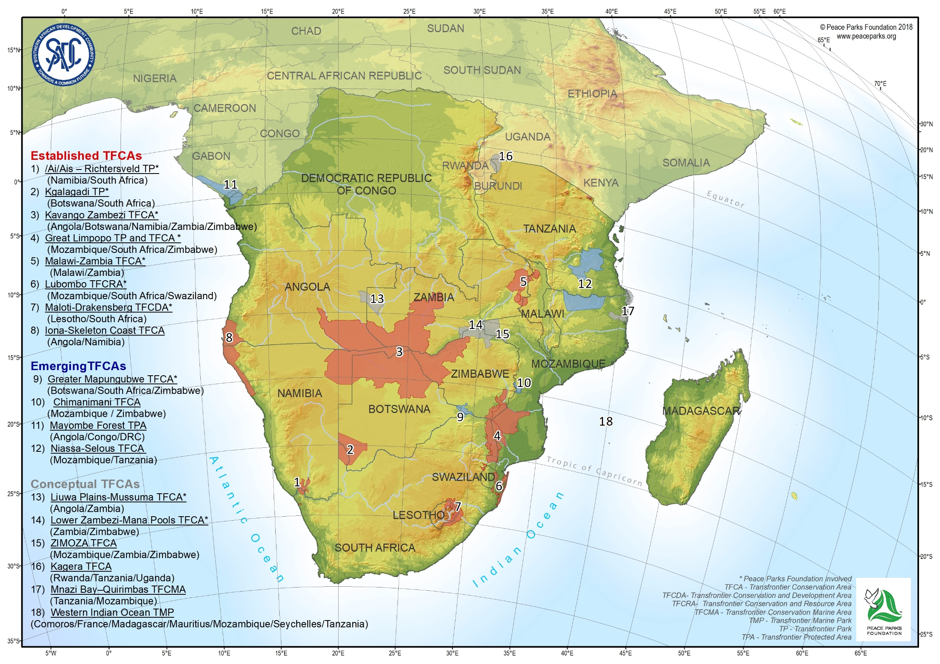

Slide 3
The SADC TFCA Programme (2013)
Vision
SADC, a model of community centred, regionally integrated and sustainably managed network of world class transfrontier conservation areas.
Mission
To develop SADC into a functional and integrated network of transfrontier conservation areas where shared natural resources are sustainably co-managed and conserved to foster socioeconomic development, and regional integration for the benefit of those living within and around TFCAs and mankind at large.

Slide 4
Key components of the SADC TFCA Programme
1. Advocacy and Harmonization
2. Enhancement of financing mechanisms for TFCAs
3. Capacity building for TFCA stakeholders
4. Establishment of data and knowledge management systems
5. Enhancement of local livelihoods
6. Reducing vulnerability to the effects of climate change
7. Development of TFCAs into marketable regional tourism products

Slide 5
The history of the Network
Established at Inception workshop in September 2013 (Johannesburg, RSA), attended by 9 SADC MS
In response to SADC TFCA Programme Component 4 on establishment of Data and Knowledge Management Systems
Establishment of platforms for knowledge management and information exchange
Establishment of a Monitoring and Evaluation Framework

Slide 6
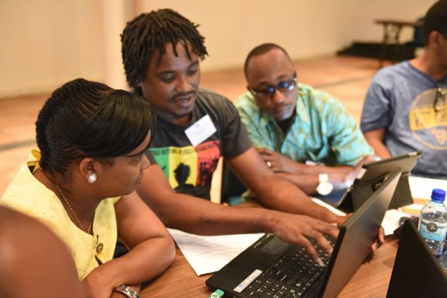
To overcome TFCA challenges through shared learning, knowledge management and collaboration
Purpose
(what?)
Practise
(how?)
People
(who?)

Slide 7
Currently more than 300 members subscribed to the Network portal
Open to all stakeholder groups/individuals
Guided & led by a Steering Committee (SC) comprising TFCA Focal Points from all SADC MS + SADC Secretariat
Around 50% government and 50% NGOs, donors, academia, private sector, community representatives
Purpose
(what?)
Practise
(how?)
People
(who?)

Slide 8
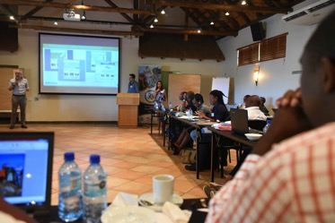
Objectives of the Network
Purpose
(what?)
Practise (how?)
People
(who?)
1. Information exchange:
Sharing experiences within and across TFCAs
Conducting field visits to enhance understanding of local contexts
2. Joint learning and knowledge management:
Developing a portal as a platform for joint learning, information exchange and knowledge management
Developing a regional repository of TFCA related information
Innovation and idea testing through joint experimentation and documentation
Knowledge product development
Enabling peer review and feedback
3. Resource mobilisation
4. Strengthening collaboration and relationships:
Conducting face to face meetings
Developing linkages with TFCA stakeholder groups
Facilitating empowerment at the level of the TFCA

Slide 9
Tangible results (I)
Annual face-to face meetings
Information exchange: development of online communication platform for network members and a public website in 2014– www.tfcaportal.org
Strong relationships between TFCA Focal Points and other practitioners and stakeholders to bring the TFCA agenda forward
Preparation of recommendations to SADC decision-making bodies
Resource Mobilization (e.g. TFCA Financing Facility)
Establishment of regional Communities of Practice:
Knowledge Management and M&E; Tourism; Training & Capacity Building, Community Engagement and Law Enforcement & Anti-Poaching
Improved marketing for TFCA through improved regional coordination with Boundless Southern Africa
Notes:
German ( ca. 145 M €), USAID (ca. 72 M US$), EU (9 M €))

Slide 10
Tangible results (II)
Participation to leading global events for conservation:
2014 IUCN World Parks Congress in Sydney (Australia)
2016 CITES COP 17 in Johannesburg (RSA)
2018 CBD COP 14 in Sharm el Shaik (Egypt)
Contribution to guideline & frameworks development:
Establishment & Development of TFCAs
Tourism Concession Guidelines
Community Engagement Guidelines
Monitoring and Evaluation Framework
Cross-border tourism products Guidelines
Realization that political commitment for TFCAs needs to be reaffirmed: Organizing a regional SADC Transfrontier Conservation Summit in 2020 (proposed host Zimbabwe)
Notes:
German ( ca. 145 M €), USAID (ca. 72 M US$), EU (9 M €))

Slide 11
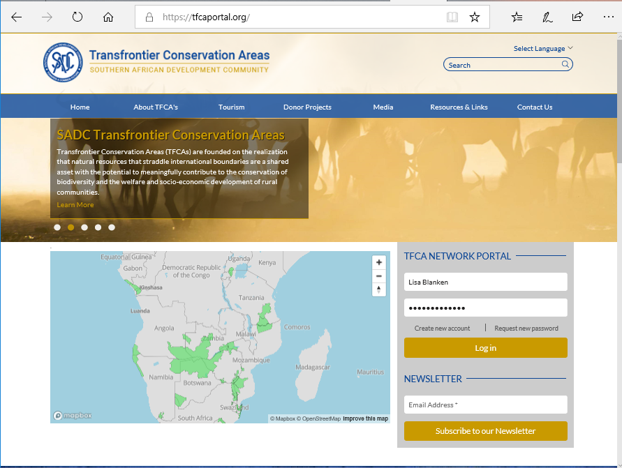

Slide 12
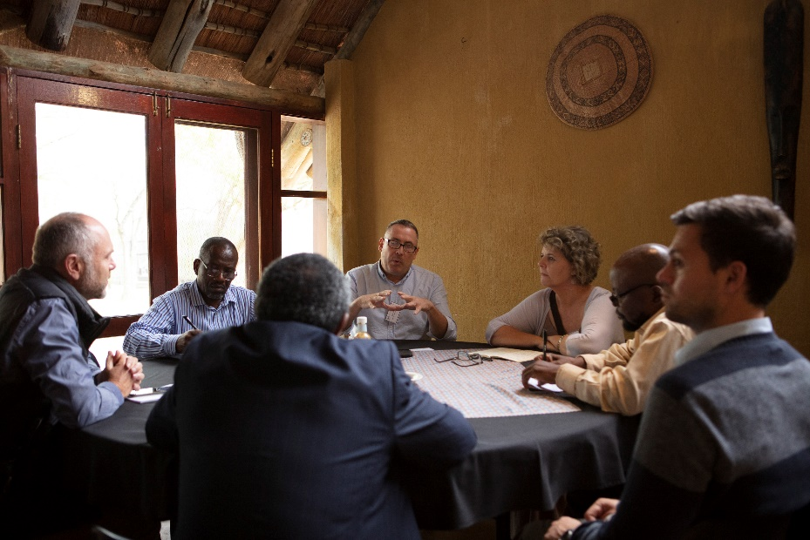
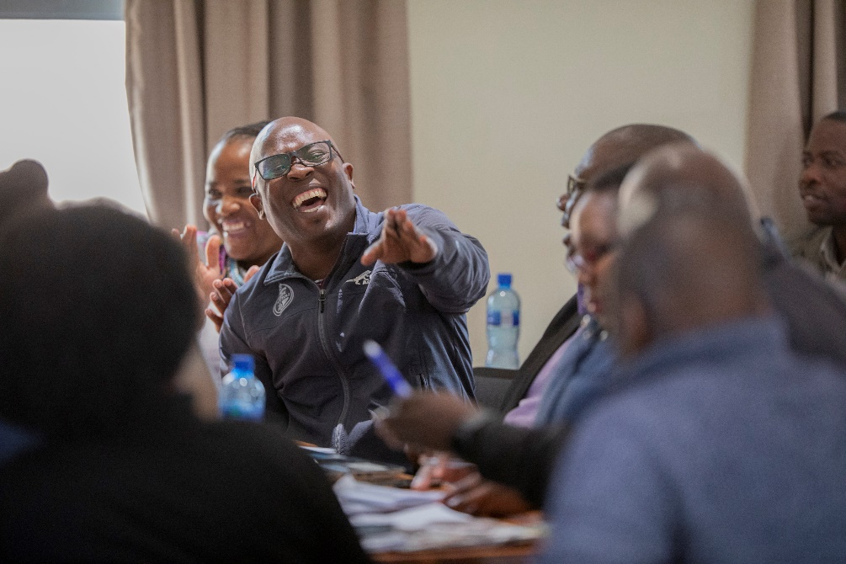
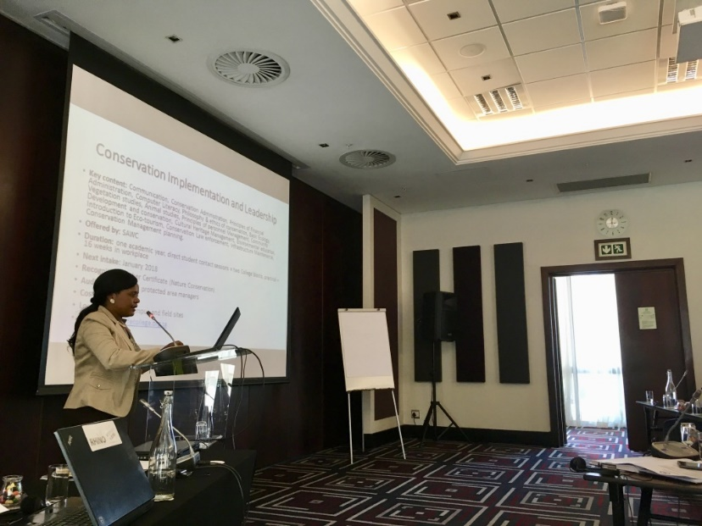
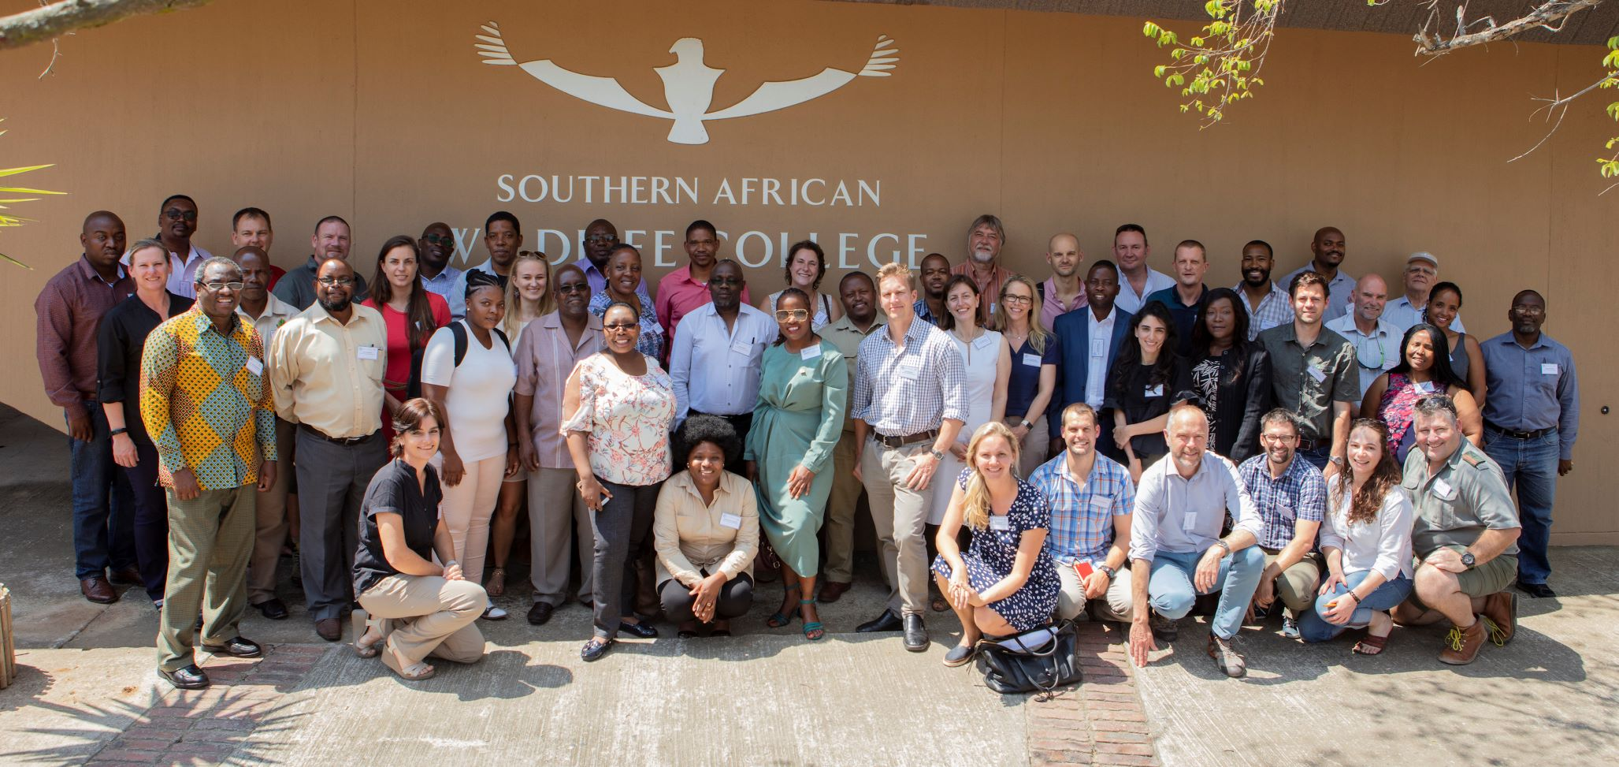

Slide 13
Challenges
High dependency on few donors (e.g. GIZ)
Slow uptake of SADC TFCA Portal and management of social media communication
Weak administration and technical capacities within SADC TFCAs
Slow domestication of Protocols, Policies and Guidelines
High dependency on Network coordination and facilitation to follow-through with decisions

Slide 14
Way forward
Continue to work on a strong regional and international Network of practitioners & experts
Work towards medium to long-term sustainability of the TFCA Network
Capacity development and institutional strenthening
Resource mobilisation (partnerships) and investment promotion (private sector)
Revisit purpose and functioning of the Network beyond its inception face with key strategic partners and the SADC TFCA Unit

Slide 15
Thank you
www.sadc.int
www.tfcaportal.org

