Slide 1


SADC TFCA Network: A Recap

Slide 2

“Network”
A form of cooperation
Group of people connecting
Guided by a common purpose
Other forms exist
Networks characterised by being:
more loose, open & fluid with larger membership
represent interests, agendas & resources of organisations
more topic & interest oriented forms
The form is just a tool – not the goal
Name isn’t as important as the purpose, the people & the practise
End goal is to see the lessons learnt within the network, applied outside
Has the cooperation added value? – measure & evaluate
Diversity within communities make them stronger – heterogeneity is better
These forms of cooperation are live, dynamic and evolving
Experiment, learn, improve & iterate - ~ Nancy White
Purpose
(what?)
Practise
(how?)
People
(who?)

Slide 3
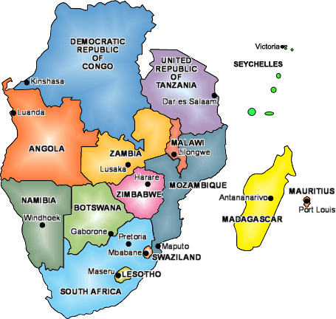

Inception Workshop 25-26 September, Johannesburg, RSA
Inspired by the SADC TFCA Programme (2013):
Component 4: Establishment of Data and Knowledge Management Systems
Information exchange, learning and innovation network which facilitates the gathering, processing and dissemination of TFCA related information
Attended by 9 SADC MS

Slide 4

Common Challenges identified:
Developing a cross sectoral approach to TFCA development - nationally and regionally
Effective governance of TFCAs at the level of
Institutions
Policies & legislation
Sustainable financing mechanisms for TFCAs
Enhancing community benefits and capacity development
Demonstrating the value of TFCAs at the local, national and regional levels

Slide 5
Themes most relevant to TFCA development:
Governance
Legal provision
Policy harmonisation
Cross border law enforcement
Conservation management
Tourism development
Community involvement
Benefit sharing
Sustainable financing
Research
Monitoring and Evaluation

Slide 6

Value Added of Network for SADC MS
Finding common solutions to common challenges
Sharing experiences
Developing a regional repository of TFCA related information
Enabling peer review and feedback
Developing linkages with TFCA stakeholder groups
Strengthening collaboration and relationships
Conducting field visits to enhance understanding of local contexts
Facilitating empowerment at the level of the TFCA

Slide 7

Purpose of SADC TFCA Network:
To overcome TFCA challenges through shared learning, knowledge management and collaboration

Slide 8
Membership & Governance:
Core Membership of the network shall be drawn from:
National level: TFCA Focal Points/Nat’l Coordinators
Local level : Agency Focal Points
Regional level: TFCA Int’l Coordinators/Secs
SADC Secretariat
3-5 nominees from each SADC MS
Extended Membership from other stakeholder groups on invitational basis
Champions to drive both TFCA development and network activities
Steering Committee to provide strategic guidance & report & advise SADC TC on Wildlife on key recommendations & network activities
Malawi: Sam Nyanyale
Zimbabwe: Alec Dangare
Mozambique: Afonso Madope
SADC Secretariat: Bartolomeu Soto

Slide 9



Focus of activities for period Oct 2013-Mar 2014
Building relationships
Data and content publishing
Meetings

Slide 10


Activity Plan
1. Immediate next steps
Submission of names by each MS for Champions and core network members | Core membership and Champions for the network confirmed | 30 September 2013 | MS
Presentation of TFCA network at upcoming SADC Ministers of Environment meeting in Maputo, Mozambique | Noting by the SADC TC and SADC Ministers of Wildlife of the network | 3 October 2013 | SADC Secretariat

Slide 11
Activity Plan contd..
2. Organising further meetings (online & face-to-face) of core membership
SC and network Champions to meet at the upcoming meeting in Maputo, Mozambique | First meeting of network SC | 30 September 2013 | SC
Meeting of network core members |  | March 2014 | SC

Slide 12

Activity Plan contd..
3. Data & content publishing through portal development
Portal Specification Document (cycle and approval by network members) | Approved Portal Specification Document | 30 November 2013 | MindQ, GIZ, SC
Approval for funding for development of the portal | Funding made available for development | 30 November 2013 | GIZ
Brand and logo design for the network | Approved brand and logo for the network | 31 December 2013 | SC, Core
Content submissions by core members | Appropriate content submitted for the portal | 15 November 2013 | SC, Core
Design and development of the public portal | Public portal available | 31 January 2014 | MindQ
Design and development of the restricted portal | Restricted portal for core members | 24 March 2014 | MindQ
Handover and administrator training (self-sufficiency) | Portal handed over and administrator trained | 31 March 2014 | MindQ

Slide 13
Activity Plan contd…
4. Building relationships amongst network members & other TFCA personnel
Conduct stakeholder mapping for each TFCA | Stakeholder mapping document with comprehensive listing of stakeholders for each TFCA available | 31 December 2013 | National Focal Points, Consult.
Develop basic database of the stakeholders identified in 4.1 and core members | Information database available | 31 December 2013 | Consult.
Encourage more joint activities at various levels of TFCAs (e.g. monitoring, research, law enforcement, cultural activities) | More opportunities for stakeholders to interact & develop relationships | Ongoing | National Focal Points/ Int’l Coords

Slide 14
Activity Plan contd…
5. Other activities
Explore synergies with the IUCN BIOPAMA initiative | Increased synergies with other initiatives | 30 November 2013 | SADC Sec
Extended membership to the network considered for each MS and TFCA based on Activity 4.1 | Membership of network extended beyond the core | End of March 2014 | Core members
Key recommendations from Inception Workshop
To fill the position of the SADC TFCA Focal Point within the SADC Secretariat as soon as possible.
To develop a specific SADC Protocol on TFCAs.

Slide 15
Description Doc
Comments received from:
WWF
An opportunity for the network to promote more of a bottom-up approach to TFCA development i.e. through engagement of communities
Specify what “empowerment” entails in section 1.2.2
Specify in section 1.2.3 that the network recognises and acknowledges that local communities WILL be engaged in the network and that require organisation, institutional strengthening and awareness raising in order to play their role effectively
Include the issue of equity in the Section 1.2.3
GLTP-AHEAD Network
Financing of Champions should be considered
No need for additional formal structures such as working groups, task teams etc.

Slide 16
Workshop Report
Comments received from:
WWF:
GLTP-AHEAD Network
Lubombo
All incorporated into the current document

