Slide 1

Overview of the Network
Lisa Blanken
TFCA Network Adviser
GIZ/SADC TUPRNR

Slide 2
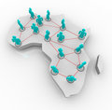
Background
SADC TFCA Network established at Inception workshop, Sept 2013, in Jhb, RSA attended by 9 SADC MS
In response to SADC TFCA Programme Component 4
  Establishment of Data and Knowledge Management Systems
  Information exchange, learning and innovation network which facilitates the gathering, processing and dissemination of TFCA related information

Slide 3
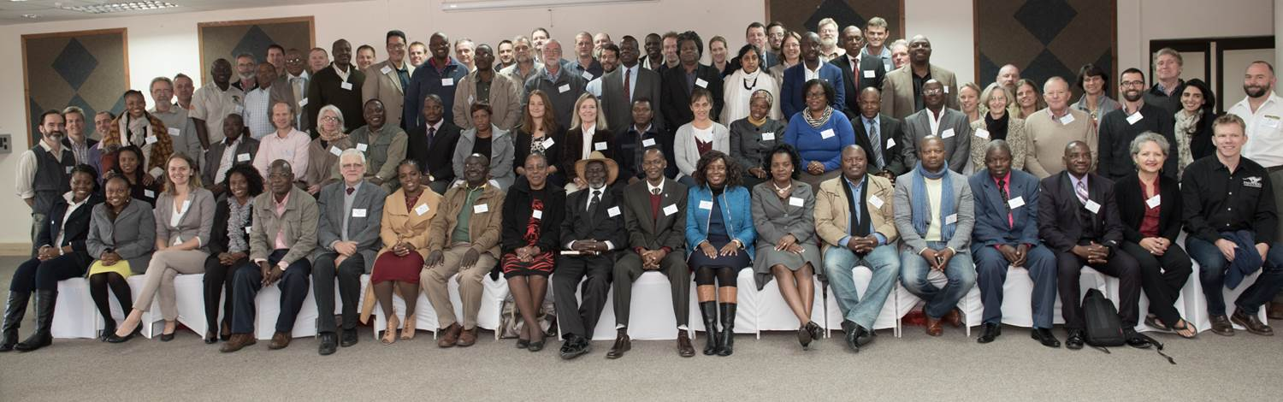
SADC TFCA Network
To overcome TFCA challenges through shared learning, knowledge management and collaboration
Purpose
(what?)
Practise
(how?)
People
(who?)
Network Symposium 2016

Slide 4
Purpose
(what?)
Practise
(how?)
People
(who?)
Open to all stakeholder groups
Guided & led by a Steering Committee (SC) comprising TFCA Focal Points from all SADC MS + SADC Secretariat
Chairing of SC changes as per SADC Troika. (Current chair RSA; outgoing chair Swaziland; incoming chair Namibia)

Slide 5
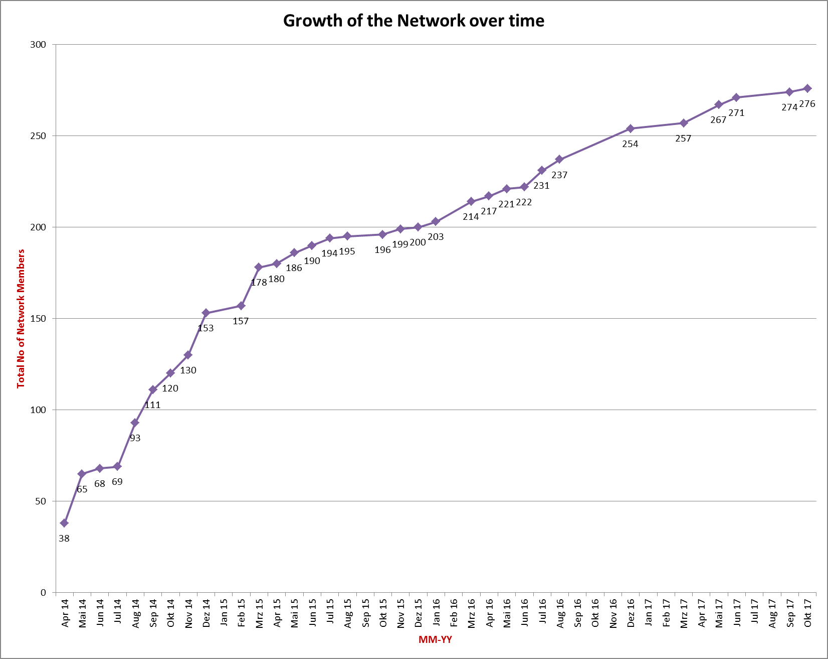
Network membership

Slide 6
Purpose
(what?)
Practise (how?)
People
(who?)
Information exchange:
  Sharing experiences within and across TFCAs
  Conducting field visits to enhance understanding of local contexts
Joint learning and knowledge management:
  Developing a portal as a platform for joint learning, information exchange and knowledge management
  Developing a regional repository of TFCA related information
  Innovation and idea testing through joint experimentation and documentation
  Knowledge product development
  Enabling peer review and feedback
Resource mobilisation
Strengthening collaboration and relationships:
  Conducting face to face meetings
  Developing linkages with TFCA stakeholder groups
  Facilitating empowerment at the level of the TFCA

Slide 7
Activities 2015-2017
Face to face meetings (1-2 annually)
Development of online communication portal for network members and a public website, incl. a TFCA Network newsletter (2016)
Support to guideline development
  Establishment & Development of TFCAs (2015)
  Tourism Concession Guidelines (2015)
  Cross-border tourism products (under development)
  Community engagement in TFCA (under development)
Setting up SADC TFCA Learning Partnership Micro Fund - with support from SADC/GIZ TUPNR (2017-2018)
Support to development of SADC TFCA M&E Framework (under development)

Slide 8
Regional and international presence
SADC TFCA Network Symposium 2016 in Gaborone, Botswana on collaborative management models for conservation areas
Presence at Global Seminar on Transboundary Cooperation for Biodiversity and Peace in Salzburg, Austria in 2016
Strong presence at CITES COP17 hosted in Johannesburg, South Africa, from September-October 2016
  4 side events
  Exhibition stand
Participation at the International Tourism Fair (ITB) in Berlin, Tourism INDABA in Durban and World Travel Market in Cape Town (2017) – together with Boundless Southern Africa

Slide 9
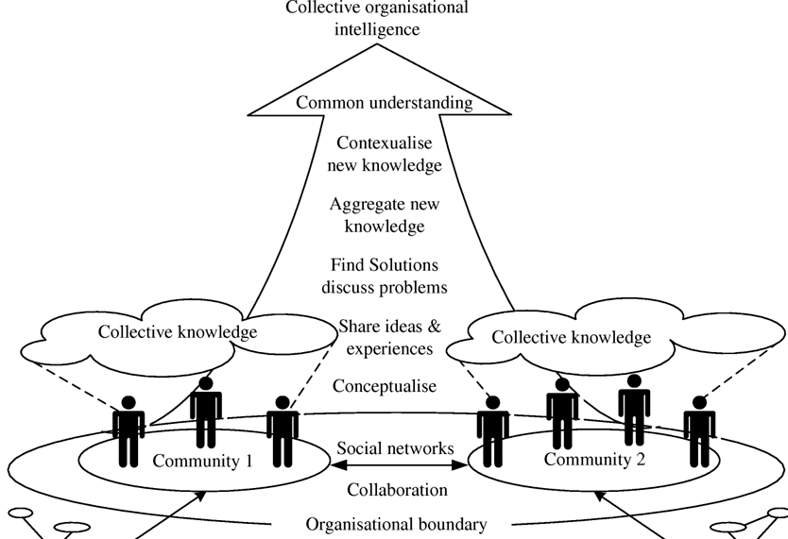
Community of Practices
March 2016 - establishment of 4 Communities of Practices on; Tourism, Monitoring, Data Management and Training & Capacity Building
Potential to develop the Network into a knowledge hub
CoPs around thematic areas can aggregate & analyze existing data, suggest solutions to challenges & offer expertise
These CoP are made up out of individuals, experts and specialists in the field with a broad stakeholder representation
CoPs can evolve and dissolve according to the needs on TFCA development

Slide 10
Link between TFCA Network and CoPs
TFCA Network meetings
Presenting progress on meetings, membership and activities
Table recommendations
Possibility to organise separate sessions at Network meeting, or find the resources to organise a topical Network meeting
TFCA Network Steering Committee
Sharing Minutes of meetings
Chair/convener of CoP asked to prepare a brief report-back
Technical Committee on Wildlife/Ministerial meetings
Suggest solutions and/or table recommendations on behalf of the TFCA Network

Slide 11
Tourism CoP
Learning from practice
Lisa Blanken
TFCA Network Adviser
GIZ/SADC TUPNR

Slide 12
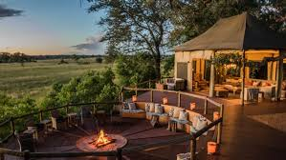
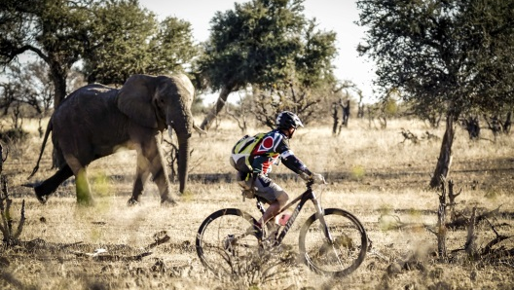
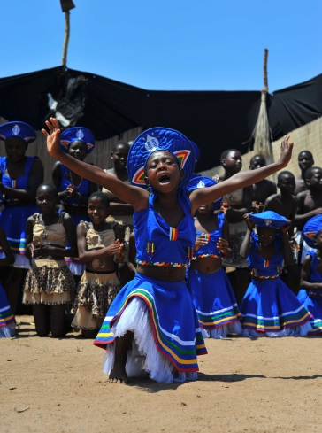
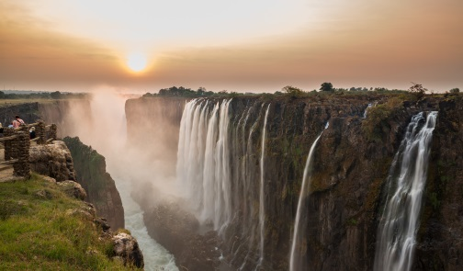
Rationale for Tourism COP
Marketing of tourism and tourism development in TFCAs currently more focused on individual protected areas or specific renown sites like Victoria Falls.
Boundless Southern Africa is an initiative established by 9 SADC Member States to market the 6 TFCAs bordering South Africa + KAZA – Bringing out the potential of cross-border tourism products/events
  Currently missing:
  1 central place to find tourism information on all SADC TFCAs
  Besides Univisa & KTP/GLTP examples, limited movement of tourists
  Regional vision for tourism development in TFCAs, incl. economic potential

Slide 13
Tourism CoP - overview
Tourism CoP established in March 2016 with initially five members
April 2016: ToRs developed and shared with the TCoP members
April – August 2016: Additional experts approached by various members of the TCoP
July 2016: First discussion between TCoP members during TFCA Network Symposium held in Gaborone, Botswana
August 2016: First meeting discussing ToRs & way forward
January 2017: Meeting to support preparations for ITB Berlin 2017
February 2017: Planning meeting redefining focus areas and objectives, roles & responsibilities and presence at tourism fairs
March 2017: Presenting recommendations at TFCA Network meeting
July 2017: Meeting to evaluate presence at tourism fairs
September 2017: Preparing concept note for presentation at TC on Wildlife
October/Nov 2017: Presenting concept note with recommendations at TC on Wildlife and RETOSA board

Slide 14
Relevant SADC protocols and programmes
SADC Programme for Transfrontier Conservation Areas (2013)
  Component 5: Enhancement of local livelihood
    Increased private and public investments in TFCA tourism
  Component 7: Development of TFCAs into marketable regional tourism products
SADC Protocol on the Development of Tourism (1998)
  Article 5: Travel facilitating
  Article 7: Marketing and promotion
TFCA Development Strategy for 2010 and Beyond (2005)
  Positioning TFCAs as tourism and investment destinations through establishment of ‘Boundless Southern Africa’ brand
Purpose: Enhance the marketability and sustainability of cross-border tourism in SADC TFCAs.

Slide 15
Objectives
Focus areas | Objectives
Product Development | - Development of cross-border tourism products and routes for SADC TFCAs - Support, where relevant and appropriate the establishment of rural community tourism products in and around SADC TFCAs - Advocate for removal of obstacles that hinder development of tourism industry in SADC TFCAs
Marketing and Promotion | - Enhancement of coordinated marketing and promotion of SADC TFCAs
Sustainable Financing and Promotion | Increase private sector engagement and investment in SADC TFCAs Support establishment of equitable community partnerships in the TFCA tourism industry

Slide 16
Roles & responsibilities
Convener/Chair | Sue Snyman (Wilderness Safaris)
Secretariat | Lisa Blanken (GIZ)
Product development lead | Paul Bewsher (PPF)
Marketing and promotion lead | Roland Vorwerk (Boundless Southern Africa)
Sustainable financing & investment lead | Steve Johnson (Chemonics)
Chair is heading the TCoP and often initiates meetings/drafts first agenda’s
Secretariat is supporting logistics and coordinating sponsorships
Different coordinators are appointed that take the lead on specific focus areas. Also responsible for making work plan on their focus area
Membership includes representation from TFCA Network SC

Slide 17
Membership
Sue Snyman (Wilderness Safaris) | Piet Theron (GLTP)
Lisa Blanken (GIZ) | Shareen Thude (Open Doorz CC.)
Paul Bewsher (PPF) | Manuel Bollmann (Fair Trade Tourism)
Roland Vorwerk (Boundless) | Rod de Vletter (Lubombo TFCA
Steve Johnson (Chemonics) | Nomsa Mabila (Lubombo TFCA)
Ernest Mokganedi (DEA) | Patience Gandiwa (GMTFCA
Anna Spencely (IUCN TAPAS) | Steve Collins (RESILIM)
Tawanda Gotosa (SADC) | Glynn O’Leary (Transfrontier Park Destinations),
Thembi Kuene (RETOSA) | Uwe Sturmann (Tourism Results)
Kenneth Racombo (RETOSA) | Kwakye Donkor (Africa Tourism Partners)
Caroline Ungersbock (Sustainable Tourism Partnership Programme) | Nakedi Maputla (AWF)

Slide 18

Questions?

