Slide 1
USAID Southern Africa
Resilient Waters Program
Presented to SADC TFCA NETWORK
13 June 2019

Slide 2
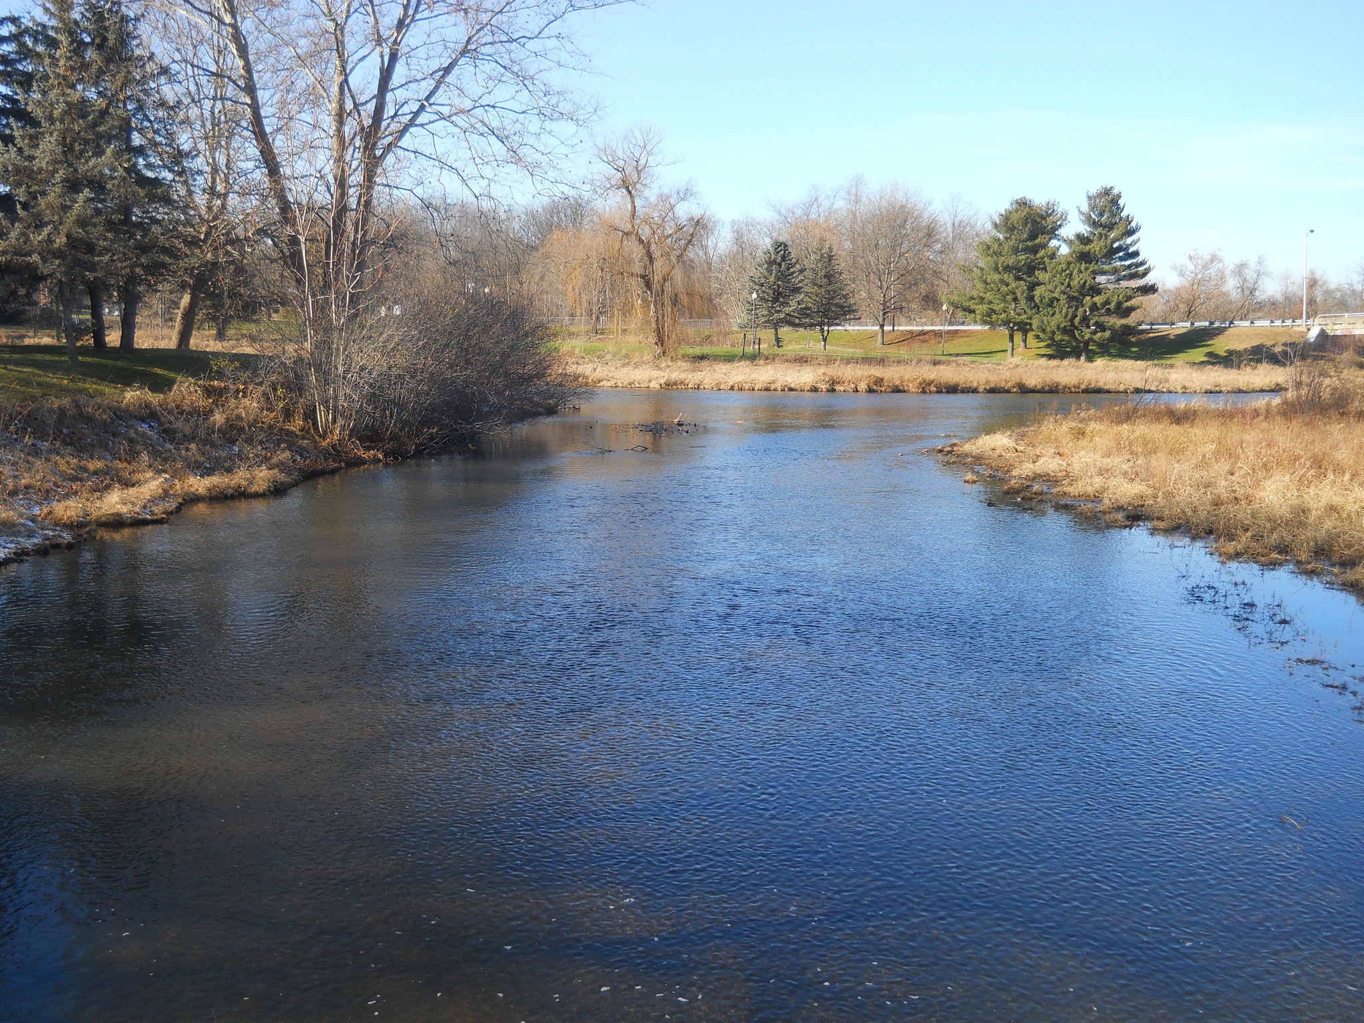
Project Objective
To build more resilient and water secure Southern African communities and ecosystems through improved management of transboundary natural resources and increased access to safe drinking water and sanitation services.
Notes:
USAID has a long history of strengthening resiliency in the region where, throughout the 1990s
it supported CBNRM programs like the Communal Areas Management Program for Indigenous Resources (CAMPFIRE) in Zimbabwe, NRMP in Botswana, and Living in a Finite Environment (LIFE) in Namibia.
To enhance this work’s sustainability and acknowledge the importance of a regional perspective in conservation, USAID shifted its focus in the 2000s to supporting SADC River Basin Organizations (RBOs), starting with the Okavango Integrated River Basin Management Project program and then working through the Chemonics-implemented SAREP and RESILIM activities
Under RESILIM and SAREP, USAID was able to achieve the following (talk about results in PPT slide)

Slide 3
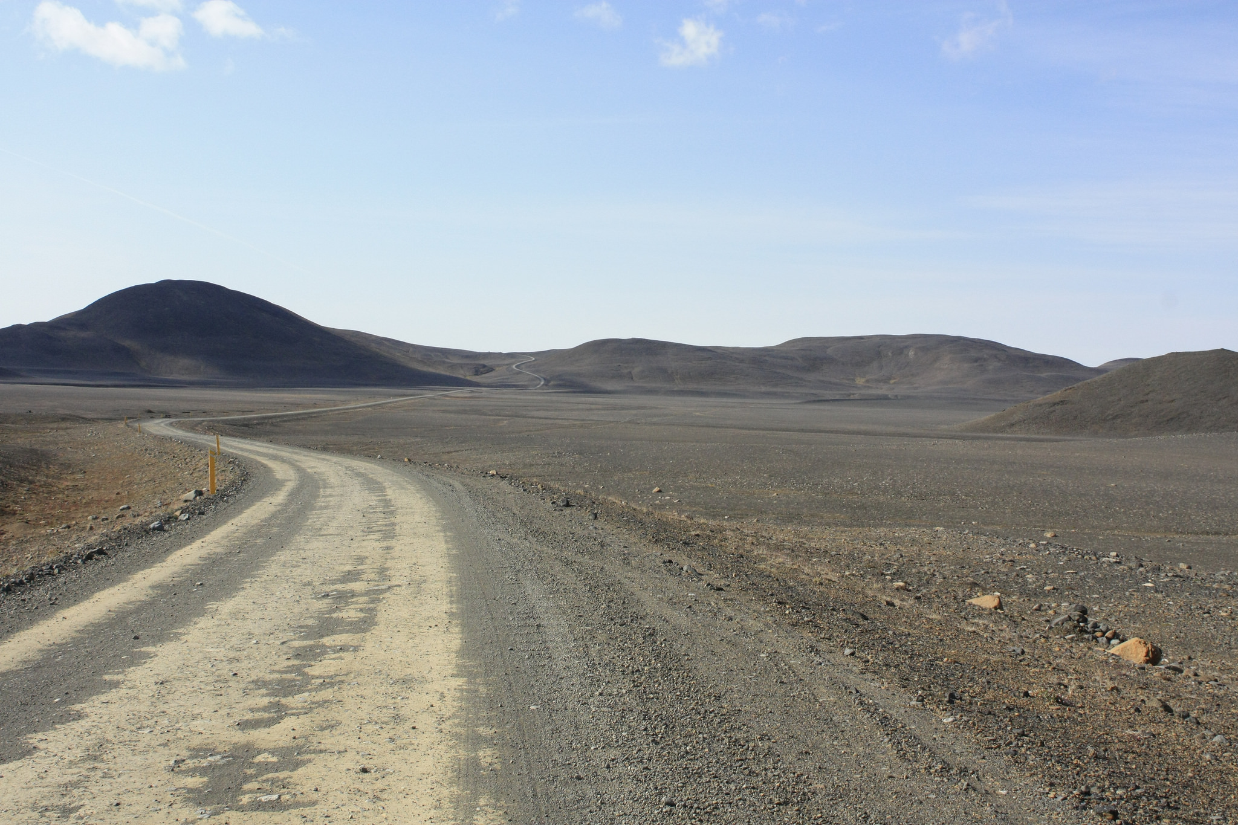
Project Approach
To achieve this objective, the Resilient Waters Program collaborates with regional institutions, including river basin organizations (RBOs) and Transfrontier Conservation Areas (TFCAs), national governments, and communities to:
Enhance cooperation
Enhance capacity
Leverage partnership opportunities, and
Monitoring, evaluation and learning.
Notes:
USAID has a long history of strengthening resiliency in the region where, throughout the 1990s
it supported CBNRM programs like the Communal Areas Management Program for Indigenous Resources (CAMPFIRE) in Zimbabwe, NRMP in Botswana, and Living in a Finite Environment (LIFE) in Namibia.
To enhance this work’s sustainability and acknowledge the importance of a regional perspective in conservation, USAID shifted its focus in the 2000s to supporting SADC River Basin Organizations (RBOs), starting with the Okavango Integrated River Basin Management Project program and then working through the Chemonics-implemented SAREP and RESILIM activities
Under RESILIM and SAREP, USAID was able to achieve the following (talk about results in PPT slide)

Slide 4
Integrated Components
Management and security of transboundary water resources in selected river basins improved
Access to safe, sustainable drinking water and sanitation services in selected areas increased;
The ability of key institutions and targeted communities to adapt to the impacts of change strengthened; and
The conservation of biodiversity and ecosystem services in key areas in Southern Africa improved
  sustainable resource management.
Notes:
USAID has a long history of strengthening resiliency in the region where, throughout the 1990s
it supported CBNRM programs like the Communal Areas Management Program for Indigenous Resources (CAMPFIRE) in Zimbabwe, NRMP in Botswana, and Living in a Finite Environment (LIFE) in Namibia.
To enhance this work’s sustainability and acknowledge the importance of a regional perspective in conservation, USAID shifted its focus in the 2000s to supporting SADC River Basin Organizations (RBOs), starting with the Okavango Integrated River Basin Management Project program and then working through the Chemonics-implemented SAREP and RESILIM activities
Under RESILIM and SAREP, USAID was able to achieve the following (talk about results in PPT slide)

Slide 5
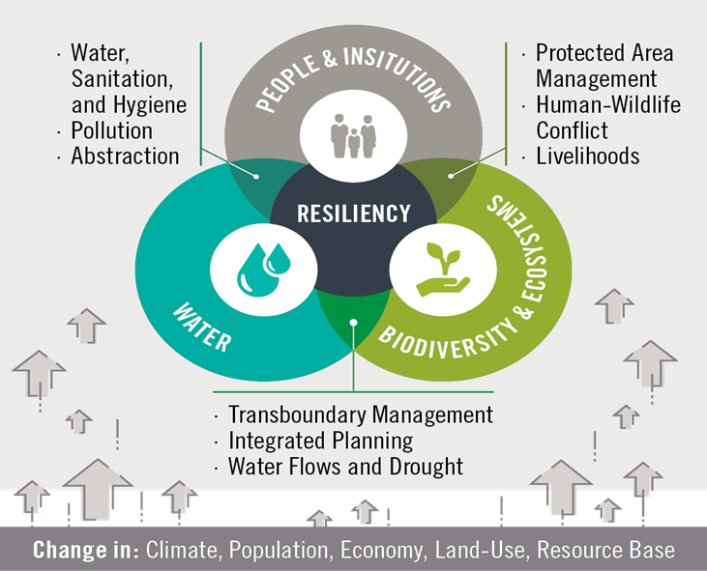
Conceptual Framework
Notes:
Resilient Waters activity is a 5 year USAID-funded activity with that aims to build more resilient and water secure Southern African communities and ecosystems through improved management of transboundary natural resources and increased access to safe drinking water and sanitation services.
Resilient Waters has four integrated objectives, which are intended to reinforce each other to improve overall water security and resilience of communities and ecosystems.

Slide 6
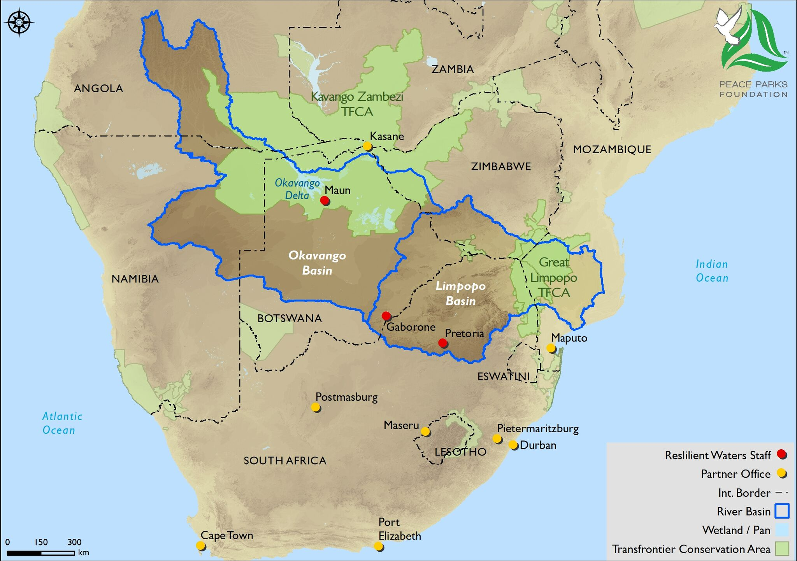
Presence and Priority Intervention Areas
Notes:
Building on USAID’s investments in the region to increase resilience, we will take a three-tiered approach to geographic prioritization. The Limpopo and Cubango-Okavango basins are in the highest tier, as they represent USAID’s greatest investments and progress to date; through them we can capitalize on our experiences and relationships from SAREP and RESILIM. The second tier includes areas closely linked to the first-tier basins. These areas present an opportunity to make a major impact with low-entry costs by, for example, harmonizing policies in the broader KAZA TFCA with those of OKACOM and incorporating Lesotho into Limpopo planning processes given Lesotho’s inter-basin transfers to the Limpopo system. To determine areas in the third-tier, we will look for places throughout the region that would enable us to capitalize on prior or ongoing USAID support, like the Orange-Senqu basin and Combatting Wildlife Crime (CWC) sites (e.g., the Malawi-Zambia transfrontier landscape). As the map in Exhibit 5 on the next page shows, the RBO and TFCA geographies have considerable overlap, providing significant opportunities to identify synergies. Our team has the strong regional presence and is poised to make the most of opportunities as they emerge across the region.
Resilient Waters is only a part of USAID’s long-term regional vision, and we will work with the Chemonics-implemented South Africa Low Emissions Development (SA-LED) program; the planned CWC program; RESILIM-Olifants; and other USAID-supported activities (e.g., under the Global Resilience Partnership) through quarterly meetings to support the mission’s overall approach and objectives. We will form a Strategic Advisory Group with partners’ CEOs, RBOs’ executive secretaries, USAID, SADC, and community leaders to develop and track work plans and identify new collaboration opportunities. We will take advantage of free platforms widely in use in southern Africa (e.g., WhatsApp) to create groups for ad hoc and targeted coordination.

Slide 7
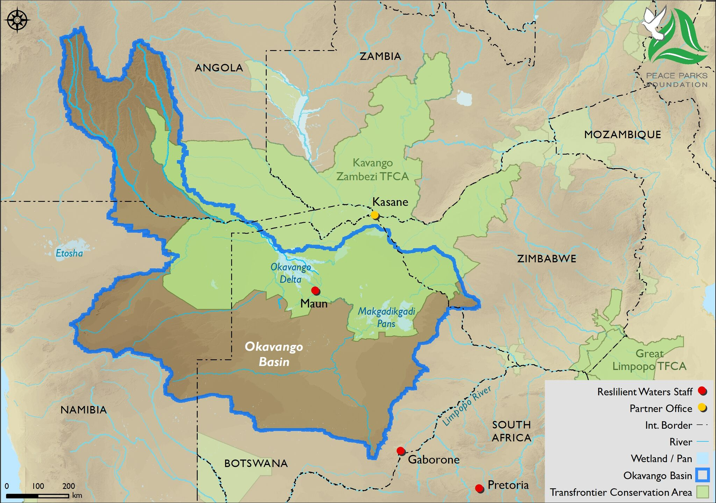
Okavango Program Footprint
Notes:
Building on USAID’s investments in the region to increase resilience, we will take a three-tiered approach to geographic prioritization. The Limpopo and Cubango-Okavango basins are in the highest tier, as they represent USAID’s greatest investments and progress to date; through them we can capitalize on our experiences and relationships from SAREP and RESILIM. The second tier includes areas closely linked to the first-tier basins. These areas present an opportunity to make a major impact with low-entry costs by, for example, harmonizing policies in the broader KAZA TFCA with those of OKACOM and incorporating Lesotho into Limpopo planning processes given Lesotho’s inter-basin transfers to the Limpopo system. To determine areas in the third-tier, we will look for places throughout the region that would enable us to capitalize on prior or ongoing USAID support, like the Orange-Senqu basin and Combatting Wildlife Crime (CWC) sites (e.g., the Malawi-Zambia transfrontier landscape). As the map in Exhibit 5 on the next page shows, the RBO and TFCA geographies have considerable overlap, providing significant opportunities to identify synergies. Our team has the strong regional presence and is poised to make the most of opportunities as they emerge across the region.
Resilient Waters is only a part of USAID’s long-term regional vision, and we will work with the Chemonics-implemented South Africa Low Emissions Development (SA-LED) program; the planned CWC program; RESILIM-Olifants; and other USAID-supported activities (e.g., under the Global Resilience Partnership) through quarterly meetings to support the mission’s overall approach and objectives. We will form a Strategic Advisory Group with partners’ CEOs, RBOs’ executive secretaries, USAID, SADC, and community leaders to develop and track work plans and identify new collaboration opportunities. We will take advantage of free platforms widely in use in southern Africa (e.g., WhatsApp) to create groups for ad hoc and targeted coordination.

Slide 8
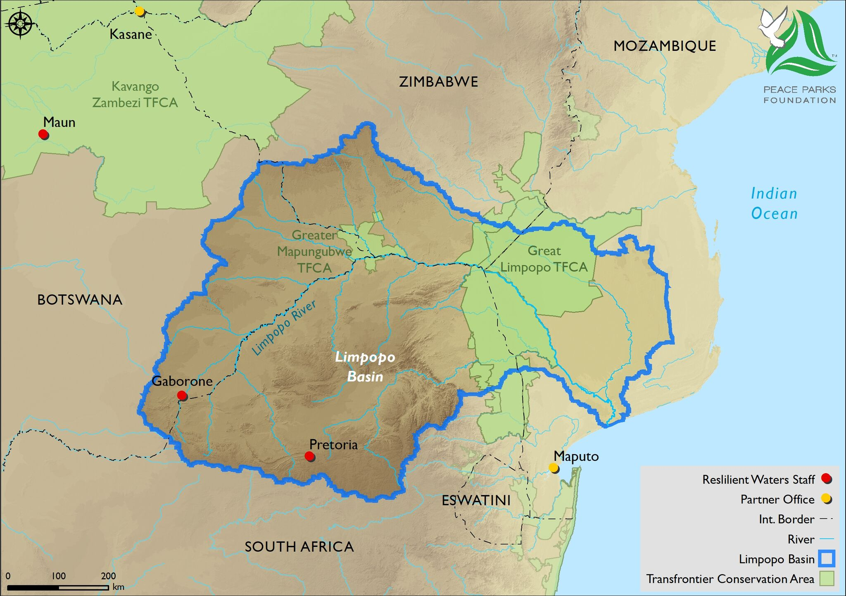
Limpopo Program Footprint
Notes:
Building on USAID’s investments in the region to increase resilience, we will take a three-tiered approach to geographic prioritization. The Limpopo and Cubango-Okavango basins are in the highest tier, as they represent USAID’s greatest investments and progress to date; through them we can capitalize on our experiences and relationships from SAREP and RESILIM. The second tier includes areas closely linked to the first-tier basins. These areas present an opportunity to make a major impact with low-entry costs by, for example, harmonizing policies in the broader KAZA TFCA with those of OKACOM and incorporating Lesotho into Limpopo planning processes given Lesotho’s inter-basin transfers to the Limpopo system. To determine areas in the third-tier, we will look for places throughout the region that would enable us to capitalize on prior or ongoing USAID support, like the Orange-Senqu basin and Combatting Wildlife Crime (CWC) sites (e.g., the Malawi-Zambia transfrontier landscape). As the map in Exhibit 5 on the next page shows, the RBO and TFCA geographies have considerable overlap, providing significant opportunities to identify synergies. Our team has the strong regional presence and is poised to make the most of opportunities as they emerge across the region.
Resilient Waters is only a part of USAID’s long-term regional vision, and we will work with the Chemonics-implemented South Africa Low Emissions Development (SA-LED) program; the planned CWC program; RESILIM-Olifants; and other USAID-supported activities (e.g., under the Global Resilience Partnership) through quarterly meetings to support the mission’s overall approach and objectives. We will form a Strategic Advisory Group with partners’ CEOs, RBOs’ executive secretaries, USAID, SADC, and community leaders to develop and track work plans and identify new collaboration opportunities. We will take advantage of free platforms widely in use in southern Africa (e.g., WhatsApp) to create groups for ad hoc and targeted coordination.

Slide 9
Biodiversity Activities in the KAZA
Support biodiversity and ecosystem monitoring
  Expand initiatives and institutionalization of the Wildlife Monitoring System
  Conduct first basin-level monitoring and joint survey, including biological monitoring, in collaboration with EU, UNDP-GEF, and KAZA
Provide technical assistance for management of critical habitats, including those projected to be most affected by climate change
  Review existing management plans for key protected areas
  Develop and draft action plans for protection of key areas
  Initiate technical assistance and delivery
Implement priority biodiversity conservation activities to enhance benefits to vulnerable populations
  Identify prioritization areas and site selection of livelihood interventions
  Begin issuance of livelihood grants
Provide Technical Capacity Building support to KAZA Secretariat
  Embed human resources to improve capacity
Notes:
Resilient Waters activity is a 5 year USAID-funded activity with that aims to build more resilient and water secure Southern African communities and ecosystems through improved management of transboundary natural resources and increased access to safe drinking water and sanitation services.
Resilient Waters has four integrated objectives, which are intended to reinforce each other to improve overall water security and resilience of communities and ecosystems.

Slide 10
Livelihood Activities in the KAZA
Provide assistance to municipalities and/or competent local authorities on planning for and guiding land use changes
Land Use Conflict resolution tools/skills enhancement, including LUCIS
Leverage funding to support conservation-based livelihoods
Identify feasibility studies and community development plans
Establish PPPs supporting community-based tourism developments, or leverage private sector investment and develop capacity within associated communities
Network communities and funders
Communications staff member
Notes:
Resilient Waters activity is a 5 year USAID-funded activity with that aims to build more resilient and water secure Southern African communities and ecosystems through improved management of transboundary natural resources and increased access to safe drinking water and sanitation services.
Resilient Waters has four integrated objectives, which are intended to reinforce each other to improve overall water security and resilience of communities and ecosystems.

Slide 11
GLTFCA support
Institutional support
Program co-ordinator / implementation Manager based in Maputo
Institutional reform process
Development of a Marketing and Communications Strategy for the GLTFCA
Integrated water resource management plan
Community development
Livelihood support through the grants program
Notes:
Resilient Waters activity is a 5 year USAID-funded activity with that aims to build more resilient and water secure Southern African communities and ecosystems through improved management of transboundary natural resources and increased access to safe drinking water and sanitation services.
Resilient Waters has four integrated objectives, which are intended to reinforce each other to improve overall water security and resilience of communities and ecosystems.

Slide 12
Thank you

