Slide 1
Guidelines & Conference on Concessioning & Sustainable Tourism Investment in TFCAs in SADC
Dr Anna Spenceley
annaspenceley@gmail.com
Maseru Sun Hotel, Lesotho, 26 June 2014

Slide 2
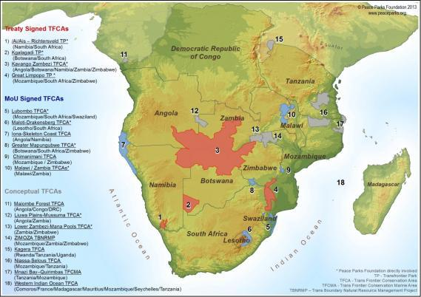
Why do we need tourism concession
guidelines for SADC TFCAs?
Notes:
Why do we need tourism concession guidelines for SADC TFCAs
Series of TFCAs in SADC – some with tourism plans, and some without.
Some with tourism concessions in protected areas, and some not
Some countries have highly sophisticated PA issues for concessions (e.g. SANParks, Namibia) – some have good established particular guidelines (e.g. hunting in Mozambique – Niassa), others don’t have any yet.
TFCAs – range of different PAs & also interstitial areas
Image: PPF

Slide 3
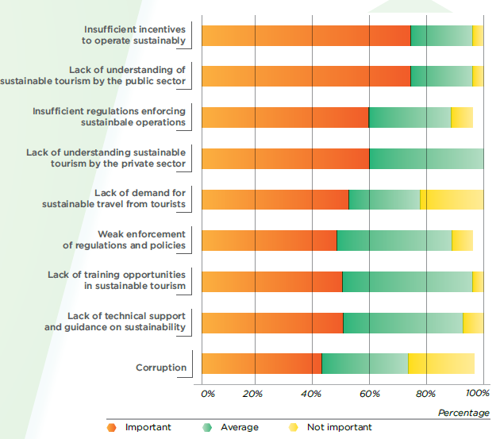
Address barriers to mainstreaming sustainable tourism
Spenceley, 2013
Notes:
Broader issues – results of UNEP consultation on barriers to mainstreaming sustainable tourism in Southern Africa
Lack of political buy-in
Lack of steady interest from donors in tourism
Companies paying lip service to ST
Lack of funding for research on ST
Lack of voluntary certification in all southern African countries
No uniform system of assessing sustainability

Slide 4
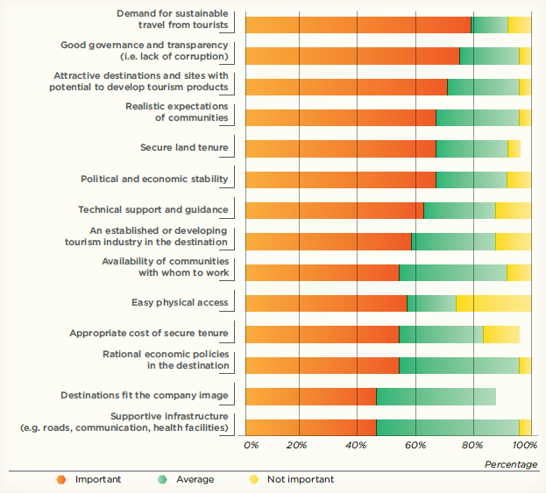
Make investment easier
Spenceley, 2013
Notes:
Will address things that the PS needs
Other issues raised:
Understanding that sustainability leads to cost savings and greater financial viability
ST develops competitive advantage for operators
Supply should match demand

Slide 5


Guidelines
Situational analysis
Conference
Scoping
Process
Notes:
‪digitallysick.com – conference sleeping
‪www.uccconferencing.ie – microphone pic
‪www.algaecal.com - signpost

Slide 6
Guidelines
Situational analysis
Conference
Scoping
Process
Notes:
‪digitallysick.com – conference sleeping
‪www.uccconferencing.ie – microphone pic
‪www.algaecal.com - signpost

Slide 7


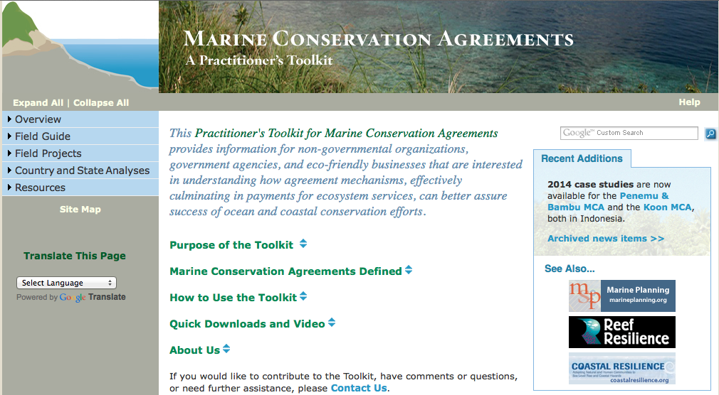
What should the guidelines look like?
Notes:
‪riaus.org.au – book
http://www.poweredtemplate.com/brochure-templates/nature/03899/0/index.html brochure

Slide 8

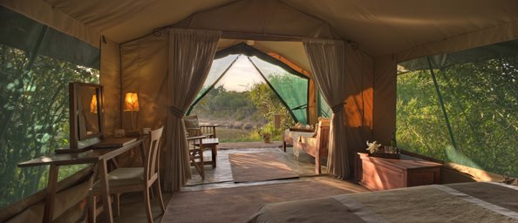
What should they include? Background
Notes:
Value that can be obtained through concessions – in fees to CA and also
Types of tourism products and services – e.g. accommodation, food
Local benefits/involvement (including equity, providing goods and services
Market viability
Contracts, and process options
Information on TFCA issues?
KAZA ppf map
© Asilia - http://www.asiliaafrica.com/Gallery/Camps-Lodges.aspx#ad-image-2
Mitchell, J., Keane, J., and Laidlaw, J. (2009) Making success work for the poor: Package tourism in Northern Tanzania, Final Report, Overseas Development Institute, London. Accessible at http://www.odi.org.uk/sites/odi.org.uk/files/odi-assets/publications-opinion-files/4203.pdf

Slide 9
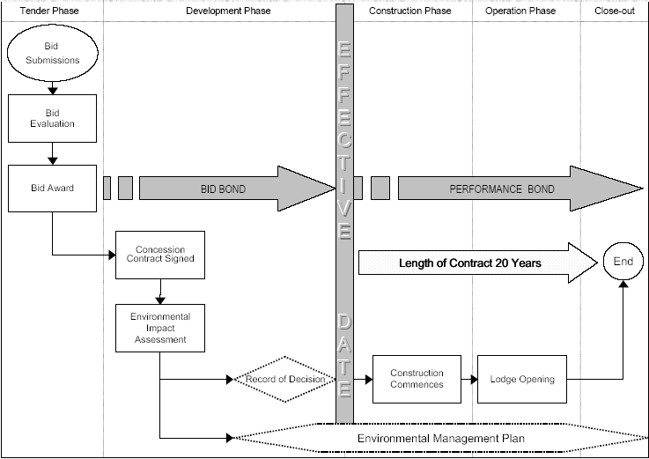
What should they include? Process
Notes:
Sanparks undated

Slide 10
Guidelines
Situational analysis
Conference
Scoping
Process
Notes:
‪Can you make it to these dates?
digitallysick.com – conference sleeping
‪www.uccconferencing.ie – microphone pic
‪www.algaecal.com - signpost

Slide 11

Day 1: Investment Workshop
Day 2-3: Guidelines development
Notes:
The purpose of the Investment Workshop (Day 1) is to:
Provide a forum for investors and key managers responsible for commercial activities in protected area (including TFCAs) to share experiences around lessons learned and best practices in the field of concessioning and tourism investment in these areas
Network between tourism investors, enterprise owners and protected area authorities and managers working on transfrontier conservation areas.
The purpose of the Concessioning Workshop (Days 2-3) is to contribute to the development of sustainable tourism concession model guidelines for TFCAs in SADC. The workshop is targeted specifically at officials responsible for commercial activities in Protected Areas including TFCAs
Talking about dates in early September (i.e. 1-3 Sept)

Slide 12

Thank you!
Dr Anna Spenceley
Email: annaspenceley@gmail.com
Presentations: www.slideshare.net/AnnaSpenceley
Website: www.anna.spenceley.co.uk

