Slide 1



GREATER MAPUNGUBWE TRANSFRONTIER CONSERVATION AREA
Coordination Tenure Update
11 March 2015
Patience Gandiwa Tlotlo Hotel & Conference Centre International Coordinator Gaborone, Botswana

Slide 2
Presentation Outline
The Greater Mapungubwe TFCA: A Brief Background: Vision, Mission, Objectives , Spatial Context
Planning & Implementation framework
GMTFCA Institutions
Key Priorities for GMTFCA Development and Suggested Wayforward
Some challenges

Slide 3
Vision: To be a world-renowned Transfrontier Conservation Area linking the Mapungubwe cultural landscape as well as the ecosystems of the Limpopo and Shashe Valleys across the international borders between Botswana, South Africa and Zimbabwe
The Greater Mapungubwe TFCA
Objectives
Establishing appropriate institutional arrangements & structures
Harmonising policy to ensure effective governance
Re-establishing wildlife movement & corridors
Facilitating social development by establishing ecotourism as a key economic activity
Ensuring a healthy & safe environment
Managing benefits from conservation & ecotourism to the region & its people
Mission
Promoting & fostering international cooperation
Conserving biodiversity across international boundaries
Protecting cultural heritage & geographic landscapes
Facilitating socio-economic benefits

Slide 4
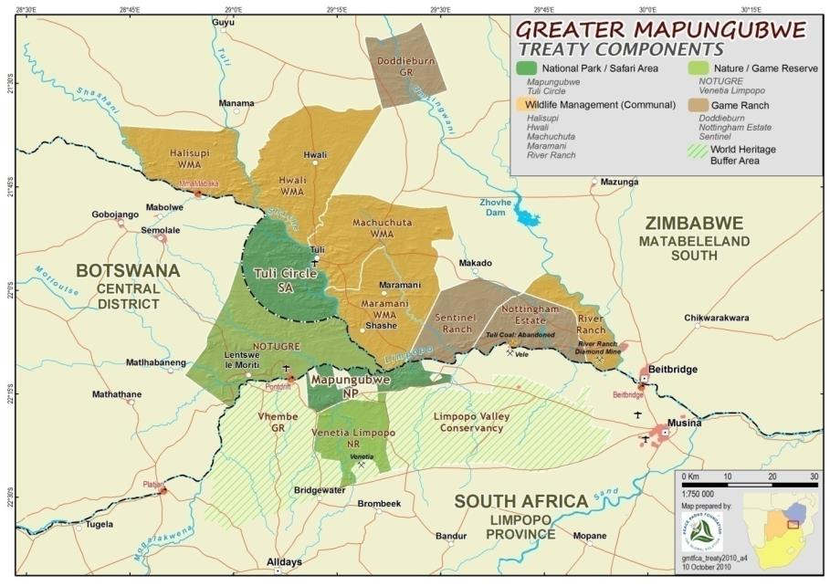
Spatial Context

Slide 5
Planning & Implementation Framework
The IDP Provides strategic direction & context for GMTFCA
Aligns national issues within a regional context
Provides clear guidelines for attaining objectives

Slide 6
The Key Performance Areas:
Any Progress?
Protected Area Planning: Tuli Circle Safari
Need-driven institutional arrangements and adjustments: PMC-RMC, Working Groups: CDHWG, CVWG
Draft Framework Document for Sustainable Financing and Task Team formed
Joint surveys: Elephants and other Large Herbivores
Joint Research: Human-Wildlife Conflicts, Exotic spp
Joint Operations: Law- enforcement, Patrols, Trainings, surveillance
Draft Framework Document for Disaster Risk Management
Cross-border Tourism: Tour de Tuli….more revenue
etc…….

Slide 7
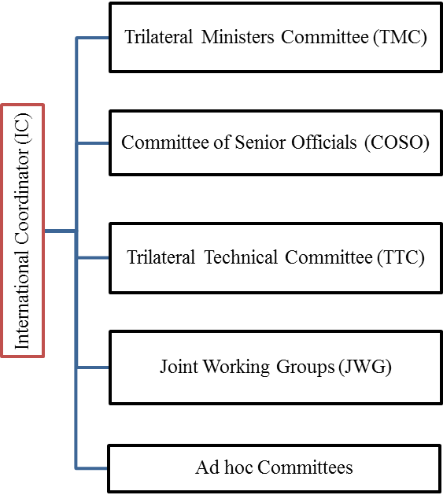
GMTFCA
Institutions
Heads of State
(Botswana, South Africa and Zimbabwe)
Cross-sectorial collaborations
Biodiversity Conservation and Veterinary Issues
National, Regional, District, Steering Committees
Tourism
Community Development
Safety and Security
Resource Managers Committee (RMC)

Slide 8
Key Priorities for GMTFCA Development and Suggested Wayforward
 | Priority | Possible Wayforward
1 | Finalisation of Name Change Discussions | A Trilateral Ministerial Decision is necessary
2 | Consolidation of the Core Area | Country-based task teams
3 | Supportive Area-based planning in sync with IDP | Planning workshop series spearheaded by the Conservation and Veterinary Working Group Reconfirmation of the TFCA boundary
4 | Joint Operations Strategies for Cross-border products , Joint Management, etc | Specialist Task Teams should be appointed and progress monitoring
5 | Sustainable funding strategy | The appointed Task team should have a road map for the desired outcome Long term and short term budget
6 | Landscape Connectivity | Promote joint research in the area and identify key joint activities for ecosystem monitoring
7 | Supportive infrastructure and operation framework for cross-border tourism products | Implementation of proposed cross border products starting with Adventure Walking Trails and Mini Tour de Tulis
8 | Benefit flow management and Community Support Programme | Strategy formulation and implementation

Slide 9
TFCA Development is generally slow and needs commitment….
The Signing of the GMTFCA Treaty is long overdue

Slide 10
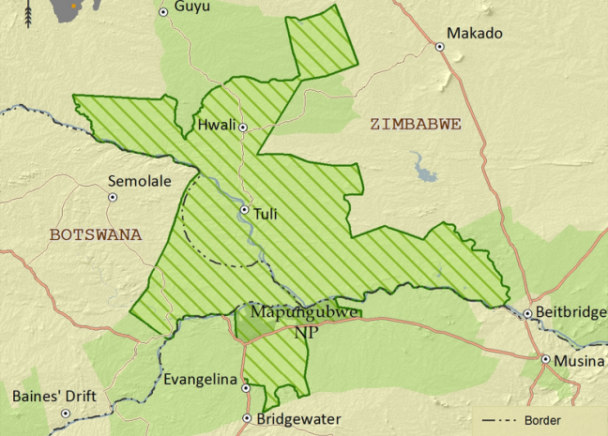
TFCA Development
100%
Continuous
Improvement
70%
50%
25%
0%
Political
Support
Planning
Establishment
Operationalisation

Slide 11
Some Challenges…that we can solve
Efficient functionality of Working Groups: Membership
Human resources at grassroots level: Local Coordination, Management disparities
Communication: Protocols, Infrastructure and Equipment for Resource Managers
Attendance of meetings

Slide 12
THANK YOU VERY MUCH
A lot of progress has been achieved since the signing of the MoU in 2006 and also during the 2013-2014 period, and maintaining the momentum is important to ensure achievement of GMTFCA objectives outlined in MoU

