Slide 1
Guidelines Working Group 2
Step 3: Procurement strategy
Step 4: Transaction management

Slide 2
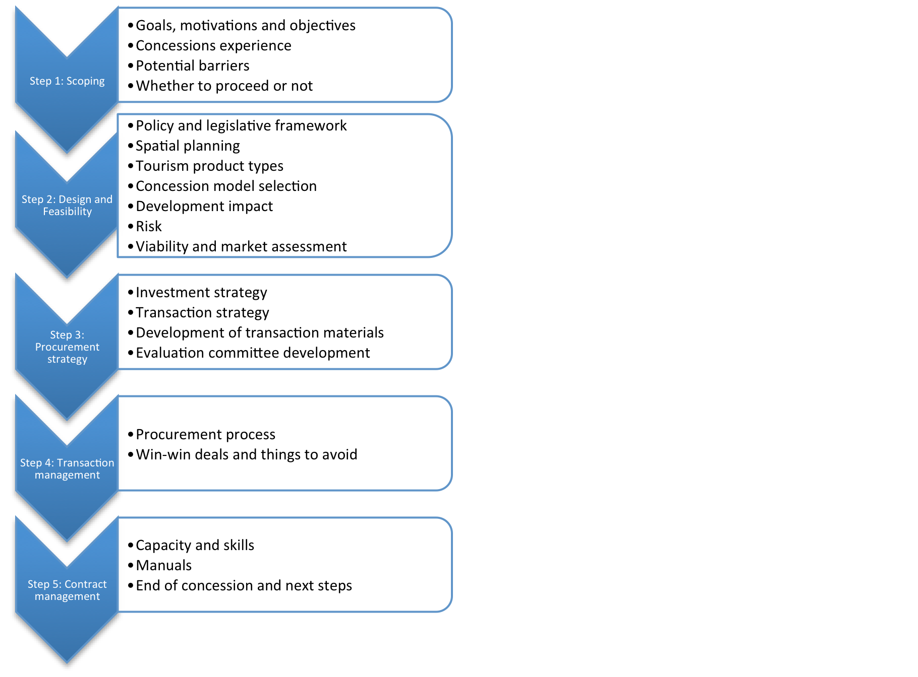
Working group activities:
Work through draft Guideline text
Note alterations and improvements
Suggest case study examples from SADC
Indicate tools that would be useful
Nominate rapporteur for report back

Slide 3
Step 3: Procurement strategy:
Group A: Investment strategy and transaction strategy
Facilitator: Boundless SA
Group B: Transaction materials, evaluation committee
Facilitator: Anna Spenceley
Step 4: Transaction management
Group C: Procurement process, win-win deals/things to avoid
Facilitator: Michael Wright

