Slide 1
Guidelines Working Group 3
Step 5: Contract management
Case studies, templates & links

Slide 2
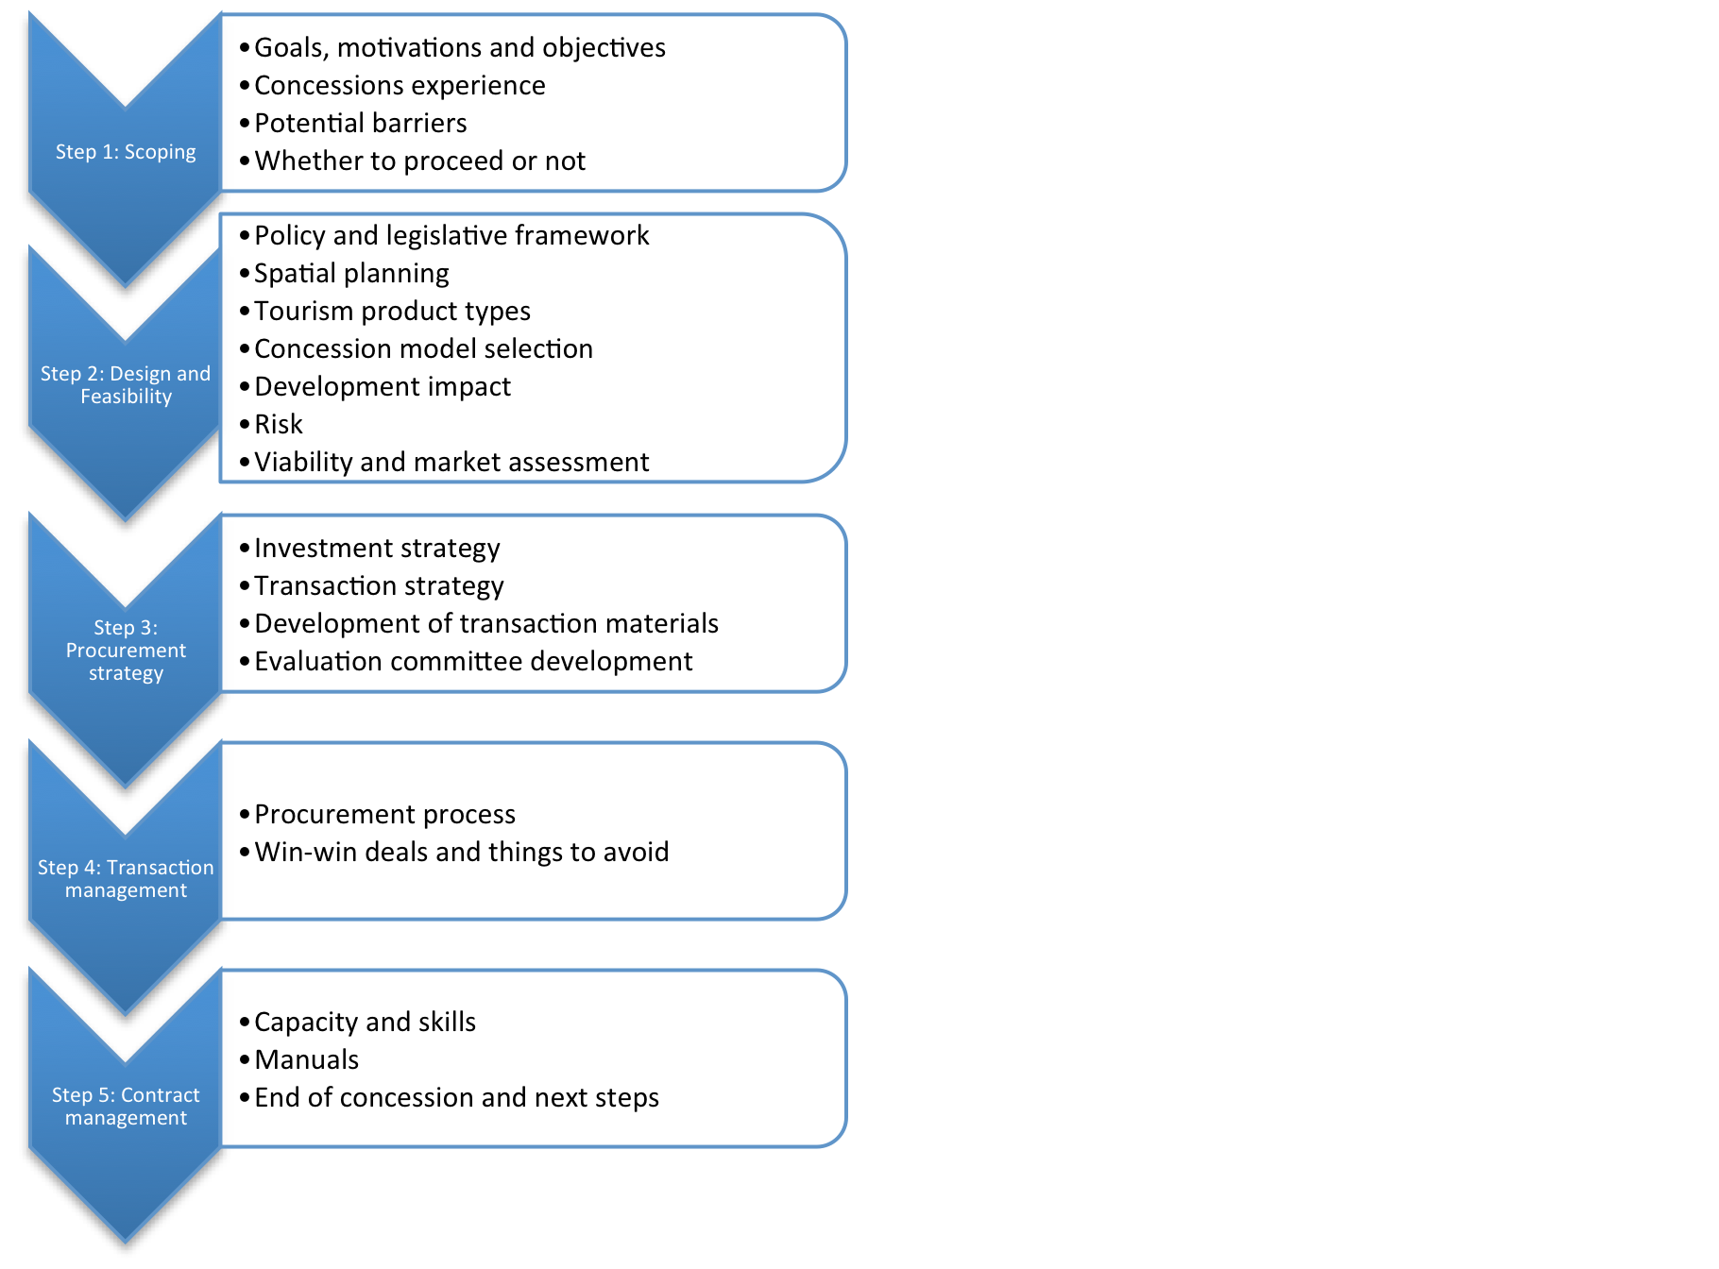
Working group activities:
Work through draft Guideline text (Step 5; Annexes)
Note alterations and improvements
Suggest case study examples from SADC
Indicate tools & links that would be useful
Nominate rapporteur for report back

Slide 3
Step 5: Contract management
Group A: Capacity and skills, manuals, end of concession & next steps
Facilitator: Michael Wright
Supporting material
Group B: Case studies, templates, links
Facilitator: Anna Spenceley

